Slide 1

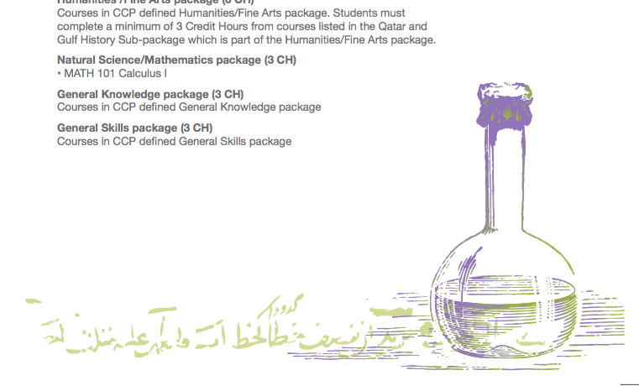
Graduate Programs-
College of Health Sciences

Slide 2
QU health Cluster
College of Medicine
College of Health Sciences
College of Pharmacy
Biomedical Sciences
Public Health
Human Nutrition
Physical Therapy and Rehabilitation Science
Undergraduate program-
Biomedical Science Program
Masters programs
Undergraduate program-
Public Health Program
Master of Public Health (MPH)
Launched Fall-2015
Undergraduate program-
Human Nutrition Program
Undergraduate program-
Physical Therapy Program
Master of Science in Biomedical Sciences
Launched Fall-2012
Master of Science in Genetic Counselling (MSc)
Launched Fall-2018
College of Dental Medicine
Master’s of Science in Human Nutrition (MSc)
To be launched
Fall-2021
PhD program in Biomedical Sciences
Launched Fall-2018

Slide 3


PhD Biomedical Sciences
A collaborative research-based multidisciplenary PhD program committed to training PhD Biomedical Sciences candidates as the next generation of health scientists and research leaders in Qatar. The proposed PhD program is designed to train doctoral-level scientists to investigate and introduce solutions to pressing research problems in the broad area of biomedical sciences.

Slide 4

PhD Biomedical Sciences
The first batch for PhD program was in 2018.
The duration of the curriculum and program of study is four years of total 60 credit hours.
The curriculum will incorporate lectures, group projects, presentations, journal club and writing review articles.
All courses will be taught in English.

Slide 5
Study Plan
The program is divided into three layers of courses:
  The first layer is common to all admitted students and consists of 2 courses (6 credit hours in total).
  The second layer consists of 3 discipline specific core courses. A total of 44 credit hours of dissertation are required from each student.
  The third layer consists of one course specialty-related electives (3 credit hours).

Slide 6

Typical milestones for incoming students
Enrollment in core, elective and advanced courses to develop a broad foundation and specialization in biomedical sciences
Rotation through research laboratories to learn research techniques
Participation in interdisciplinary seminars
Write thesis research proposal
Passing the written comprehensive and oral candidacy examination.
Performing original research on relevant topic within concentration and publishing
results in peer reviewed international journals
Successful defense of a dissertation

Slide 7
Research Areas
Cancer
Cardiovascular
Metabolic disorders (diabetes, obesity)
Infection & immunity,
Neuroscience & mental health
Reproductive system and infertility
Profession education
Public health, human nutrition, population medicine
Drug discovery

Slide 8



PhD Dual Degrees
Royal College of Surgeons in Ireland (RCSI)
University of Alberta, Alberta- Canada
McGill University, Montreal, Canada

Slide 9

Program Requirements
A Master's degree in Biomedical Science or related areas in the research track with a minimum cumulative GPA of 3 out of 4.
Achieve a minimum score of 68 in TOEFL iBT or equivalent test taken within 2 years, OR English waiver.
Successfully pass the personal interview

Slide 10

Required Documents
Official Graduation Statement
Final and official university transcript.
Official TOEFL score report or equivalent score report
Health Certificate issued inside Qatar
A Photocopy of the applicant's Qatar ID card
Two (2) recent identical passport size photographs
Application fees: QR 350

Slide 11
Biomedical and Pharmaceutical Research Unit (BPRU)
An official launch of a new Biomedical and Pharmaceutical Research Unit (BPRU) under QU Health, started operation in January 2017.
BPRU is a dynamic and ever changing environment that gives emphasis on the establishment of interdisciplinary disease-based graduate programs around the various thematic research areas according to Qatar National priorities.
BPRU research focuses on main themes of biomedical & pharmaceutical research: Cancer, Diabetes and Metabolic Disorders, Cardiovascular Diseases, Infectious Diseases and Reproductive Medicine and Drug discovery and development.

Slide 12
Potential Supervisors at CHS
Prof. Asmaa Al-Thani
Dr Hanan Abdul Rahim
Prof. Ahmed Maliki
Dr. Marawan Abu Madi
Dr. Nasser Rizk
Dr. Hatem Zayed
Dr. Gheyath Nasrallah
Dr Mashael Alshafai
Dr Maha Alasmakh
Dr. Hadi M. Yassine
Dr. Lily O’hara
Dr. Manar El-Hassan
Dr Zumin Shi
Dr. Abdelhamid Kerkadi
Dr. Hiba Bawadi
Dr. Vijay Ganji
Dr. Layla Kamareddine
Dr Karam Adawi

Slide 13

Contact Persons for PhD Program
Dr. Feras Alali
Director of Research and Graduate Studies,
VP for Medical and Health Office feras.alali@qu.edu.qa
Mrs. Sana Alajory
Administrative coordinator for Research & Graduate Studies
sana.a@qu.edu.qa
Dr. Mashael Alshafai
Section Head of Research and Graduate Studies College of Health Sciences
malshafai@qu.edu.qa
Dr. Layla Kamareddine
Coordinator of PhD Program in Biomedical Sciences
lkamareddine@qu.edu.qa

Slide 14
THE MASTER OF SCIENCE IN BIOMEDICAL SCIENCES

Slide 15
Biomedical Sciences Masters programs
MSc in Advanced Clinical Practice with Thesis Option
Research track
MSc in Laboratory Management with Project Option
Professional/Management track

Slide 16
Program Mission
The Master of Biomedical Science program was designed in response to real and growing job opportunities in the workforce due to increasing healthcare service advancements in Qatar, and has been benchmarked in quality to equivalent programs in the USA.
The program will provide the knowledge and technical skills needed for medical laboratory and biomedical research professionals in Qatar.

Slide 17
Skills
  Theoretical knowledge
  Hands on practical expertise
  Ethics of the healthcare industry
  Critical thinking and writing abilities
  Communication skills

Slide 18
Program Information
Master of Sciences in Biomedical Sciences
Offered by the Biomedical Sciences Department at CHS
Offered for students (both males and females) holding BSc degree in Health related fields
Expected number of enrolled students per year is 10-12 students
Course duration: 2 years (36 CH)
Notes:
Start date: September 2018

Slide 19
Admission criteria
Bachelor Degree in a health-related field with a minimum GPA of 2.8 out of 4.0 or equivalent.
Minimum score of 620 TOEFL or equivalent test (e.g. IELTS score of 6.0), OR earned a previous degree from an accredited institution of higher education in a Program where English was the language of instruction.
Successfully completing an interview.
Notes:
from a university or college accredited by an international accrediting association or by the Ministry of Higher Education or comparable in that country.
taken within 2 years of the start of the intended semester of admission

Slide 20
Program standing
9th batch of students in the Master of Science in Biomedical Science (Since 2012)
Successfully graduated 66 students so far
Total of 11 admitted students/batch
Notes:
From Qatar
This year: 11 applicants

Slide 21
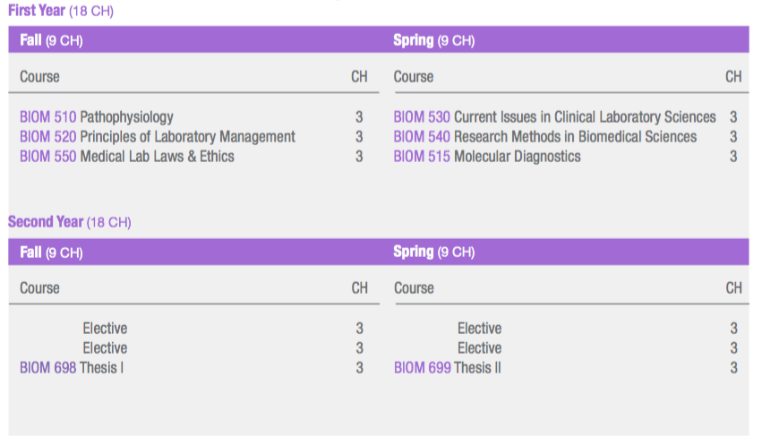
Degree Requirement and Study plan:
Concentration in Advanced Clinical Practice with thesis option (Research track)
A minimum of 36 credit hours are required to complete the Master of Science in Biomedical Sciences:
A total of 15 credit hours in Major Core Requirements A total of 21 credit hours in Concentration Requirements
- Common for both tracks - Required Courses
- Elective Courses
Electives:
BIOM 650 Pathogenic Microbiology
BIOM 651 Viral Pathogenesis and Diagnosis
BIOM 660 Biochemistry
BIOM 670 Principles of Immunochemistry
BIOM 675 Immunology and Serology
BIOM 680 Oncology
BIOM 681 Advanced Hematology
BIOM 682 Advanced Immunohematology
BIOM 665 Special topics in Biomedical Science I
BIOM 666 Special topics in Biomedical Sciences II
Major Core Requirements
Required for Thesis Track
Electives for Thesis Track
Notes:
from a university or college accredited by an international accrediting association or by the Ministry of Higher Education or comparable in that country. The minimum GPA requirement might be waived if applicant passed the Medical Laboratory Scientist (MLS) exam offered by the Board of Certification (BOC) of the American Society for Clinical Pathology.
Achieved a minimum score of 520 on the paper-based TOEFL or equivalent test taken within 2 years of the start of the intended semester of admission OR earned a previous degree from an accredited institution of higher education in a program where English was the language of instruction.
A satisfactory performance in the personal interview with the Admission committee.
Students with BS degrees in other than Biomedical Sciences are required to successfully complete the bridge courses prior to entering the Master of Science in Biomedical Science program.

Slide 22
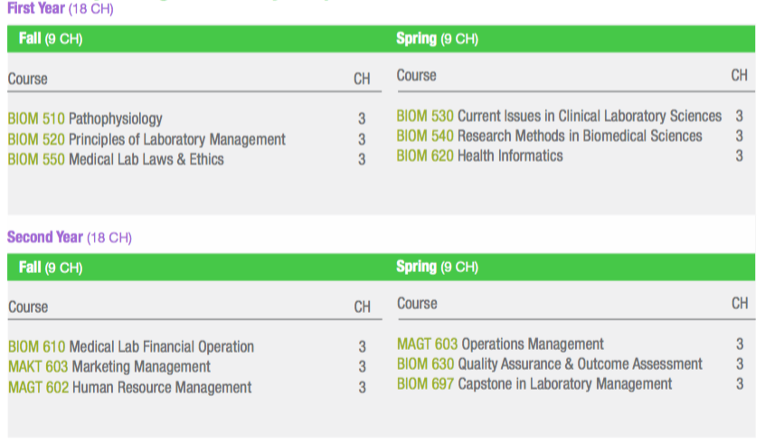
Study plan:
Concentration in Laboratory Management with capstone project option
(Professional/Management Track)
A minimum of 36 credit hours are required to complete the Master of Science in Biomedical Sciences:
A total of 15 credit hours in Major Core Requirements A total of 21 credit hours in Concentration Requirements
- Common for both Tracks - Required Courses
Major Core Requirements
Required for Management Track
Notes:
from a university or college accredited by an international accrediting association or by the Ministry of Higher Education or comparable in that country. The minimum GPA requirement might be waived if applicant passed the Medical Laboratory Scientist (MLS) exam offered by the Board of Certification (BOC) of the American Society for Clinical Pathology.
Achieved a minimum score of 520 on the paper-based TOEFL or equivalent test taken within 2 years of the start of the intended semester of admission OR earned a previous degree from an accredited institution of higher education in a program where English was the language of instruction.
A satisfactory performance in the personal interview with the Admission committee.
Students with BS degrees in other than Biomedical Sciences are required to successfully complete the bridge courses prior to entering the Master of Science in Biomedical Science program.
GPA ≥ 3
If GPA < 3: Academic Probation
*Written notification that performance is not satisfactory
*Two consecutive semesters on academic probation: Dismissal
Student’s committee and/or advisor may also decide that a student’s performance is not satisfactory
*Unsatisfactory performance may result in dismissal from the MS program

Slide 23
Graduate Certificate
in Biomedical Sciences
(Laboratory Management & Advanced Clinical Practice)

Slide 24
About the certificate
One year program
12 credit hours
Offered for students with a GPA between 2.0-2.79
Courses will be counted toward the MSc in Biomedical Sciences
Students must complete the certificate with a GPA of 3.2 or higher to be capable of applying to the master program

Slide 25
Study Plan
Graduate Certificates in Biomedical Sciences
Advanced Clinical Practice
Graduate Certificates in Biomedical Sciences
Laboratory Management
Certificate Year (12 credit hours)
Term | Course # | Course Title | Cr Hrs
Fall | BIOM 510 | Pathophysiology | 3
 | BIOM 550 | Medical Labs law and Ethics | 3
Fall Semester Total CHs |  |  | 6
Spring | BIOM 515 | Molecular Diagnosis | 3
 | BIOM 540 | Research Methods in Biomedical Sciences | 3
Spring Semester Total CHs |  |  | 6
Overall credit hours for the certificate year |  |  | 12
Certificate Year (12 credit hours)
Term | Course # | Course Title | Cr Hrs
Fall | BIOM520 | Principle of laboratory management | 3
 | BIOM 550 | Medical Labs law and Ethics | 3
Fall Semester Total CHs |  |  | 6
Spring | BIOM 630 | Quality Assurance & Outcome Assessment | 3
 | MAGT 603 | Operational Management | 3
Spring Semester Total CHs |  |  | 6
Overall credit hours for the certificate year |  |  | 12
The concluded 12 credit hours of this certificate program by the enrolled students will count towards the MSc degree in Biomedical Sciences in terms of prospect admissions.

Slide 26
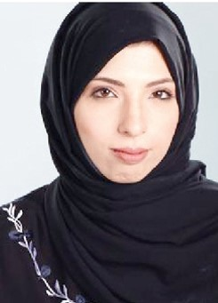

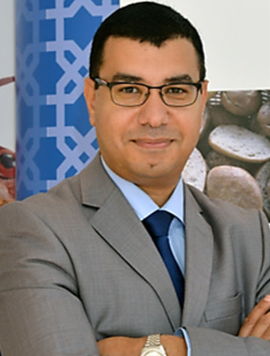
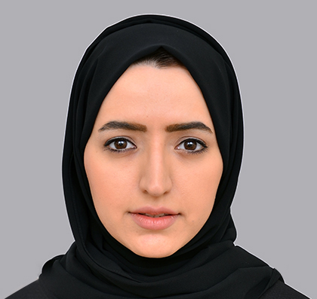
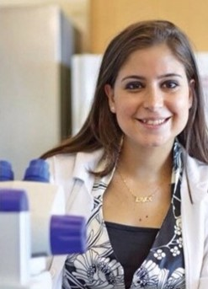
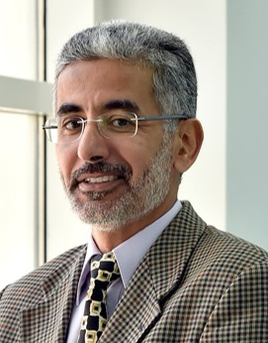
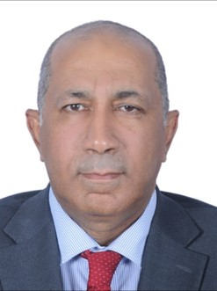
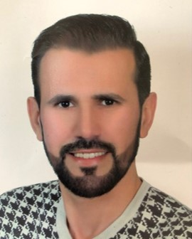
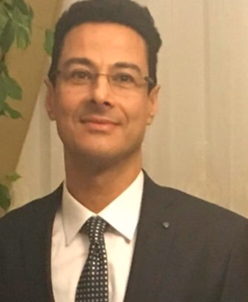
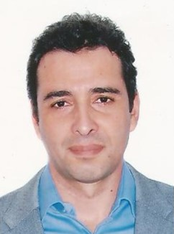
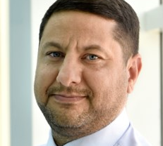
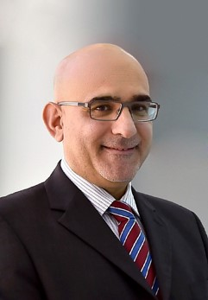
BMS Graduate Faculty
Dr.
Maha Al-Asmakh
Prof.
Asmaa Ali J F Althani
Prof.
Ahmed M. Malki
Dr.
Mashael Al-Shafai
Dr.
Layla Y. Kamareddine
Dr.
Marawan Abu-Madi
Dr.
Nasser Rizk
Dr.
Gheyath K. Nasrallah
Dr.
Hatem Zayed
Dr.
Houssein Khodjet Elkhil
Dr.
Wisam Nabeel
Dr.
Atiyeh Abdallah
Dr.
Amal Al-Haidose

Slide 27
Research Centers
QU established several research centers in the past few years, Example:
Biomedical Research Center
Environmental Science Center
Center for Advanced Materials
Laboratory Animal Research Center
Social and Economic Survey Institute
Central Lab Unit
Research labs in Health Sciences
Research Center Facilities
Molecular Biology Facilities
Flow Cytometry facility
Cell Culture facilities
Mass spectrometry facility
Imaging and Microscopy facility
Laboratory Mouse facility
Zebrafish aquatic system facility
Drosophila melanogaster Fly facility
http://brc.qu.edu.qa/research/brc/facilities

Slide 28
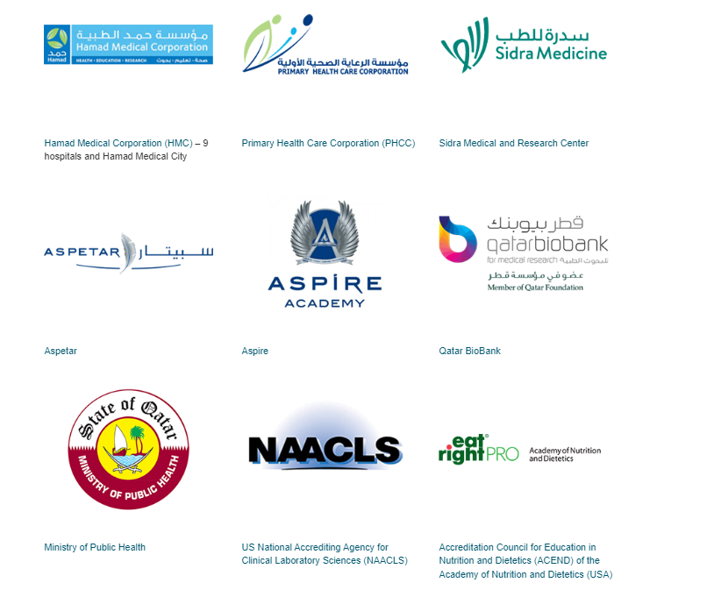
Partners and Affiliates

Slide 29
Contacts
Dr. Mashael Al-Shafai, PhD (Head of Research and Graduate Studies)
Location: Building C01, Room E121
Phone number: 4403-5589
Email: malshafai@qu.edu.qa
Dr. Layla Y. Kamareddine (BMS Graduate Programs Coordinator)
Location: Building C01, Room F205
Phone number: 4403-6015
Email: lkamarddine@qu.ed.qa
Ms. Rowda Al-Naimi (Administrative Coordinator for Research and Graduate Studies office)
Location: building C01 Room E126
Phone number: 4403-4803
Email: r.alnaimi@qu.edu.qa
Ms. Amal Ibrahim (Administrative Coordinator)
Location: building C01 Room D110
Phone number: 4403-4795
Email: amal.ibrahim@qu.edu.qa

Slide 30
Major Core Requirements
(5 courses)
Concentration Requirement
(6 courses)
BIOM 510 Pathophysiology
BIOM 520 Principles of Laboratory Management
BIOM 550 Medical Lab Laws and Ethics
BIOM 530 Current Issues in Clinical Laboratory Sciences
BIOM 540 Research Methods in Biomedical Sciences
BIOM 620 Health Informatics
BIOM 610 Medical Lab Financial Operation
BIOM 630 Quality Assurance & Outcome Assessment
MAKT 603 Marketing Management
MAGT 602 Human Resource Management
MAGT 603 Operations Management
Capstone Project
(1 course/semester)

Slide 31
MSc Advanced Clinical Practice Study Plan
First Semester – 9 CH
  Pathophysiology
  Principles of Laboratory Management
  Medical Laboratory Laws & Ethics
Second Semester – 9 CH
  Current Issues in Clinical Laboratory Sciences
  Research Methods in Biomedical Sciences
  Molecular Diagnostics
Third Semester – 9 CH
  Elective – Immunology & Serology
  Eelective - Oncology
  Thesis I
Fourth Semester – 9 CH
  Elective
  Elective
  Thesis II

Slide 32
Graduate Assistantship
GTRA
Teaching Duties
Preparing undergraduate lab sessions
Preparing undergraduate lab examinations
Exam invigilation
Research Duties
Undergraduate graduation projects
UREP projects
Writing reviews & articles
Thesis

Slide 33
Master of Science in Genetic Counselling (MSc)

Slide 34
Program Mission
To provide the healthcare sector in Qatar and the region with motivated, competent genetic counsellors that have the requisite knowledge, skills and experience to meet the needs of an expanding landscape in genetics and genomics.
Notes:
Genetic counsellors are health professionals that provide genetic counselling to patients and families with suspected genetic conditions.

Slide 35
Program Information
Master in Genetic counselling
Offered by the Biomedical Sciences Department at CHS
Offered for students (both males and females) holding BSc degree in Health related fields
Expected number of enrolled students per year is 3-4 students
Course duration: 2 years (46 CH)
Notes:
Start date: September 2018

Slide 36
Admission criteria
Bachelor Degree in a health-related field with a minimum GPA of 2.8 out of 4.0 or equivalent.
Minimum score of 620 TOEFL or equivalent test (e.g. IELTS score of 6.0), OR earned a previous degree from an accredited institution of higher education in a Program where English was the language of instruction.
Successfully completing an interview with satisfactory performance
Desired: experience (voluntary work) at a hospital or a counselling centre.
Notes:
from a university or college accredited by an international accrediting association or by the Ministry of Higher Education or comparable in that country.
taken within 2 years of the start of the intended semester of admission

Slide 37
Admission
2018/2019: 2 students
2019/2020: 3 students
2020/2021: 2 students
Notes:
From Qatar
This year: 11 applicants

Slide 38
Degree requirement
Curriculum component | Number of Courses | Total Number of Credit Hours
Required Courses in Major | 15 | 43
Elective Courses in Major | 1 | 3
Total | 16 | 46
Notes:
Number of Proposed New Courses: 12 (34 credit hours)
Number of existing courses: 4 (12 credit hours)
21 months - Sarah lawrance = 70 CH (40 academic graduate course credits,18 credits of clinical training (1,000 hours),12 credits toward a research project
Required non-credit supplemental activities)
Previous plan had 36 credit hours with ONLY 4 CH ON CLINICAL PRACTICE.
Boston (48 total credits, including summer, 8 CH on field work)
McGill (48 total credits)
Cardiff (240 total CH, 50 Clincal practice, and 60 on dissertation, 130 taught courses)
50 Credit, 21-month master of science degree program
ELECTIVES: Social and behavioral Science , Health sciences management and leadership
Social and Behavioral Science
Health Sciences Management and Leadership,Current Issues in Clinical Laboratory Sciences, Health Informatics, Advanced Special Topics in Genetic Counselling.

Slide 39
Study Plan
SECOND YEAR
Term | Course # | Course Title | Cr Hrs
Fall | GENC 620 | Advanced Principles of Genetic Counselling | 3
 | BIOM 550 | Medical Laboratory Laws & Ethics | 3
 | GENC 650 | Clinical Practice II | 4
Total |  |  | 10
Spring | GENC 615 | Seminar in Genetic Counselling | 1
 | GENC 620 | Clinical Practice III | 4
 | GENC 623 | Research Project | 3
 | XXX | ELECTIVE | 3
 | GENC 625 | Professional Development Exam
Total |  |  | 11
FIRST YEAR (25 Credit hours)
Term | Course # | Course Title | Cr Hrs
Fall | GENC 621 | Genetic Counselling Practicum I | 3
 | GENC 610 | Principles of Genetic Counselling | 3
 | GENC 611 | Cytogenetics & Developmental Biology | 2
 | GENC 612 | Medical & Human Genetics I | 3
Total |  |  | 11 CH
Spring | BIOM 515 | Molecular Diagnostic | 3
 | GENC 622 | Genetic Counselling Practicum II | 2
 | BIOM 540 | Research Methods in Biomedical Sciences | 3
 | GENC 613 | Medical & Human Genetics II | 3
Total |  |  | 11 CH
Summer (6 weeks) | GENC 640 | Clinical Practice I | 3 CH
Total |  |  | 3 CH
Electives: Social and Behavioral Science (PH), Health Sciences, Management and Leadership (PH), Current Issues in Clinical, Laboratory Sciences (BM). Health Informatics (BM), Advanced Special Topics in Genetic Counselling
Notes:
Public health master degree is 42
12 new course:
CLINICAL PRACTICE: Clinical and Metabolic Genetics Division , national center of cancer care and research, and the (Feto- maternal unit) FMU,
ELECTIVES: Social and behavioral Science , Health sciences management and leadership
4: existing
The student in the Master Program in Genetic Counselling will take 21 credit-hours of required courses in their first year, 3 in the intervening summer, and 22 CH in the second year (including 3 CH on the research project), completing a total of 46 CH before graduation.

Slide 40
Program Faculty - QU
Dr. Houssein Khodjet Elkhil
Dr. Hatem Zayed
Dr. Mashael Al-Shafai
Dr. Maha Al-Asmakh
Dr. Amal Al-Haidose

Slide 41
Guest lecturers
Guest lecturer | Department
Dr Rihab Ali Abdulrahman Karen Akouri Mariam Al-Mulla Dr Nader Al Dwick Dr Tawfeg Bin Omran | Clinical and Metabolic genetics HMC
Dr Salha Boujassoum Dr Reem Al Sulaiman | Medical Oncology department National Center of Cancer Care and Research HMC
Dr. Said Ismail | Qatar Genome Project (QGP)
Dr Shima El Bakhit Al basha | Feto-maternal department HMC
Dr Hany Gameledeen
Dr Mariam Ali M H Al-Baloushi
Dr Abdullah Awad Al Ibrahim
Dr. Fatma Almesaifri
Dr Suhad Daher-Nashif | College of Medicine QU
Dr Dominique Soekarman | Department of Medicine HMC
Notes:
15 guest lecturers

Slide 42
Clinical Team
Rotation | Instructor name | Job title | Department
Prenatal Genetics | Dr. Fatema Almusafri | Consultant Clinical/Prenatal genetics | Clinical and metabolic genetics department
Genetics (Premarital, Pediatric, adult) | Mariam Almulla | Genetic Counsellor
 | Karen El Akouri | Board Certified Genetic Counselor
Metabolic Genetics | Dr. Tawfeg Ben Omran | Senior consultant clinical/biochemical genetics & head of
 | Dr. Mariam Almurikie | Senior consultant clinical genetics
 | Dr. Noora Shahbeik | Senior consultant biochemical genetics
 | Dr. Rehab Ali Abdulrahman | Senior Consultant clinical/biochemical genetics
Cancer Genetics | Dr. Salha Bujassoum | Senior consultant medical oncology/hematology and director of hereditary cancer and high risk program | Medical Oncology department
 | Dr. Reem Al Sulaiman | Board certified genetic counsellor-
Cytogenetic/molecular lab rotation | Dr. Wafa Abu- Alainin, PhD | Clinical Scientist – training Co- coordinator Molecular Genetics Laboratory Diagnostic Genomic Division (DGD) | Department of Laboratory Medicine and Pathology (DLMP) Hamad Medical Corporation (HMC)

Slide 43
What kind of Clinical Training is involved?
3 Clinical Practices (over 3 Semesters)
Rotations at Sidra and HMC
Genetics
Prenatal
Cancer
Metabolic

Slide 44
Master of Public Health (MPH)

Slide 45
Program Mission:
The mission of the MPH program is to improve health in Qatar through a holistic, evidence-based, integrated, and inter-sectoral approach to addressing public health issues.
The program will produce qualified graduates capable of translating their knowledge and skills into public health practice at the community and health services levels.

Slide 46
Skills
  Data analytic and modelling skills
  Design and appraising of clinical and epidemiological studies
  Development of effective public health policies and practices
  Health promotion skills
  Problem solving in PH practices
  Writing and communication skills
  Public health ethics
  Leadership skills
  Computational and software skills

Slide 47
Program Information
Master of Public Health
Offered by the Department of Public Health at CHS
Offered for students (both males and females) holding BSc degree in health related fields
Expected number of enrolled students per year is 13 students
Course duration:
  Two years for full-time or four years for part-time

Slide 48
Admission Criteria
Completed a Bachelor degree or an equivalent degree in a health related field with a minimum cumulative GPA of 2.80 out of 4.00
Minimum score of 68 in TOEFL iBT or equivalent test (e.g. IELTS score of 6.5), OR earned a previous degree from an accredited institution of higher education in a program where English was the language of instruction
Successful personal interview with the Admissions Committee

Slide 49
Previous Admissions
2018/2019: 12 students
2019/2020: 11 students
2020/2021: 12 students

Slide 50
The MPH Program
The degree program has one concentration:
Epidemiology
Students will develop the capacity to plan, design, implement, analyze, interpret and appraise epidemiological studies

Slide 51
Degree requirement
42 credit hours
  18 credit hours - Major Core Requirements
  15 credit hours - Concentration Requirements
  3 credit hours - Major Electives
  6 credit hours in Thesis (Thesis1 & Thesis2) OR (Practicum & Research Project)

Slide 52
Study Plan
FIRST YEAR (21 credit hours)
Term | Course # | Course Title | Cr Hrs.
Fall | PUBH 600 | Concepts and methods of epidemiology | 3
 | PUBH 601 | Concepts and methods of biostatistics | 3
 | PUBH 602 | Social and behavioral sciences | 3
 | PUBH XXX | Major Elective * (only one Elective is required) | 3
Total |  |  | 9-12*
Spring | PUBH 603 | Research design and methods | 3
 | PUBH 604 | Foundations of environmental health | 3
 | PUBH 605 | Health services management and leadership | 3
 | PUBH XXX | Major Elective* (only one Elective is required) | 3
Total |  |  | 9-12*
SECOND YEAR (21 credit hours)
Term | Course # | Course Title | Cr Hrs.
Fall | PUBH 610 | Advanced epidemiologic methods | 3
 | PUBH 611 | Epidemiology of communicable and noncommunicable diseases | 3
 | PUBH 612 | Categorical data analysis | 3
 | PUBH 640 | Practicum (For non-thesis option only) | 3
 | PUBH 695 | Thesis 1 (For thesis option only) | 3
Total |  |  | 12
Spring | PUBH 613 | Continuous data analysis | 3
 | PUBH 614 | Evidence-based public health | 2
 | PUBH 615 | Supervised field experience- Epidemiology | 1
 | PUBH 641 | Research Project (For non-thesis option only) | 3
 | PUBH 695 | Thesis 2 (For thesis option only) | 3
Total |  |  | 9
Electives: PUBH 606 Clinical epidemiology, PUBH 607 Special topics I – New Trends in Health Services Management, PUBH 608 Special topics II – Qualitative methods

Slide 53
Important Information
About the MPH program – study plan etc
http://www.qu.edu.qa/chs/academic_programs/master_public_health/about.php
Office of graduate studies
http://www.qu.edu.qa/offices/vpcao/graduates/
Academic Policies
http://www.qu.edu.qa/research/offices/graduate-studies/graduate-academics

Slide 54
Contacts
Public Health Department, College of Health Sciences, Qatar University,
Building H12 -Annex
Dr. Manar Elhassan, PhD
  Acting Head of the Department
  Email: melhassan@qu.edu.qa, Tel: +974 4403 7506
  Dr. Karam Adawi
  MPH Program Coordinator
  Email: kadawi@qu.edu.qa , Tel: +974 4403 7508
  Ms. Sawsan Awada, MPH
  MPH Teaching Assistant
  Email: sawada@qu.edu.qa, Tel: +974 4403 6057

Slide 55
Master’s of Science in Human Nutrition (MSc)

Slide 56
Program Mission:
The mission of the MSc degree in Human Nutrition is to maintain a progressive and effective academic program that integrates graduate education, professional experience, research, and public service to develop competent graduates with the knowledge and skills necessary to satisfy and improve the diet, health, and nutritional needs of the Qatari community and communities of the Gulf region.

Slide 57
Program Information
Master's Degree in Human Nutrition
Offered by the Department of Human Nutrition at CHS
Start date: Fall 2021
Offered for students (both males and females) holding BSc degree in Health related fields
Expected number of enrolled students per year is 10 students
Course duration:
  Two years for full-time or four years for part-time (36 credits in total)
Notes:
Start date: September 2018

Slide 58
Admission Criteria
Admission application form
Completed a Bachelor level degree or an equivalent degree in a nutrition, dietetics or related health fields with a minimum cumulative GPA of 2.80 out of 4.00
Minimum score of 520 TOEFL or equivalent test (e.g. IELTS score of 6.0), OR earned a previous degree from an accredited institution of higher education in a Program where English was the language of instruction. English proficiency must have been taken within 2 years of the start of the intended semester of admission.
Applicants must submit a typed, 300-word personal statement discussing their motivation for seeking a master’s degree in view of prior formal education, current job responsibilities and career plans.

Slide 59
Admission criteria.. continued
3 letters of confidential recommendations-at least 2 from their professors of their undergraduate program and no more than one from the employer/supervisor directly sent to program coordinator
Curriculum vitae
Copy of the official transcripts
Admission to the MSc in Human Nutrition takes place only the Fall of every year.
University mandated application fees
A satisfactory performance in the personal interview (oral interview and written essay) with the Admissions Committee

Slide 60
Degree requirement
Curriculum component | Number of Courses | Total Number of Credit Hours
Required Courses in Major | 11 | 30
Elective Courses in Major | 2 | 6
Total | 13 | 36
Notes:
Number of Proposed New Courses: 12 (34 credit hours)
Number of existing courses: 4 (12 credit hours)
21 months - Sarah lawrance = 70 CH (40 academic graduate course credits,18 credits of clinical training (1,000 hours),12 credits toward a research project
Required non-credit supplemental activities)
Previous plan had 36 credit hours with ONLY 4 CH ON CLINICAL PRACTICE.
Boston (48 total credits, including summer, 8 CH on field work)
McGill (48 total credits)
Cardiff (240 total CH, 50 Clincal practice, and 60 on dissertation, 130 taught courses)
50 Credit, 21-month master of science degree program
ELECTIVES: Social and behavioral Science , Health sciences management and leadership
Social and Behavioral Science
Health Sciences Management and Leadership,Current Issues in Clinical Laboratory Sciences, Health Informatics, Advanced Special Topics in Genetic Counselling.

Slide 61
Study Plan
FIRST YEAR (18 credit hours)
Term | Course # | Course Title | Cr Hrs.
Fall | NUTR 620 | Advanced Nutrition I | 3
 | NUTR 601 | Advanced Statistics for Nutrition Research | 3
 | NUTR 640 | Nutrition care management | 3
Total |  |  | 9
Spring | NUTR 621 | Advanced Nutrition II | 3
 | NUTR 631 | Research Methods in Human Nutrition | 3
 |  | Free Elective | 3
Total |  |  | 9
SECOND YEAR (18 credit hours)
Term | Course # | Course Title | Cr Hrs.
Fall | NUTR 641 | Nutrition epidemiology | 3
 | NUTR 650 | Cardio metabolic diseases and nutrition | 3
 | NUTR 698 | Master’s Thesis | 3
Total |  |  | 9
Spring | NUTR 682 | Nutrigenomics | 2
 | NUTR 681 | Graduate Seminar | 1
 | NUTR 698 | Master’s Thesis | 3
 |  | Free Elective | 3
Total |  |  | 9
Notes:
Public health master degree is 42
12 new course:
CLINICAL PRACTICE: Clinical and Metabolic Genetics Division , national center of cancer care and research, and the (Feto- maternal unit) FMU,
ELECTIVES: Social and behavioral Science , Health sciences management and leadership
4: existing
The student in the Master Program in Genetic Counselling will take 21 credit-hours of required courses in their first year, 3 in the intervening summer, and 22 CH in the second year (including 3 CH on the research project), completing a total of 46 CH before graduation.

Slide 62
Masters Thesis
MSc is a THESIS only option program
Topic examples:
  Clinical Nutrition (Prof Vijay, Prof Hiba)
  Community nutrition (Dr. Abdelhamid, Prof. Hiba)
  Nutritional epidemiology (Prof Zumin, Prof Vijay, Prof. Hiba, Dr. Abdelhamid)
  Food science and foodservice (Dr. Tahra, Prof. Vijay)
  Nutrition Education and counseling (Prof. Hiba, Dr Abdelhamid)
Select the topic in the 2nd semester of first year

Slide 63
Important Information
About the MSc Program in Human Nutrition – Detailed description
http://www.qu.edu.qa/chs/academic_programs/master_public_health/about.php
Office of graduate studies
http://www.qu.edu.qa/offices/vpcao/graduates/
Academic Policies
http://www.qu.edu.qa/research/offices/graduate-studies/graduate-academics

Slide 64
Contacts
Human Nutrition Department, College of Health Sciences, Qatar University,
Building C01 –E126
  Dr. Tahra El Obeid, PhD
  Department Head
  Email: tahra.e@qu.edu.qa, Tel: +974 4403-4811
  Professor. Vijay Ganji, PhD, RD
  Graduate Program Coordinator
  Email: vganji@qu.edu Tel: +974 4403 4796
  Ms. Bashayer AlSulaiti
  Administrative Coordinator
  Email: balsulaiti@qu.edu.qa , Tel: +974 4403 4796

Slide 65
Admission Process:
Admission starts on Nov 29, 2020
Admission ends on March 1st, 2021
Admission section make the GPA calculations then send the final list to Office Of Graduate studies (OGS)
OGS review the final list to check the GPA then send it to the College
The College make the required Interviews/ tests..etc then send the Accepted/ rejected/waiting list (if any ) to OGS
OGS check the final list then forward it to Admission section to start send the official letters

Slide 66
Tuition Fees and Penalties:
Each credit hour costs 2000 QR.
For example: Course with 3 credits cost : 3X2000=6000 QR.
You need to pay your fees before registering for the next semester.
Semester | Time of drop or withdrawal after the end of Add/ Drop Period | Penalty
Fall and Spring | Up to 2 weeks | 20% = 1200 QR
Fall and Spring | After 2 weeks and up to 4 weeks | 50% = 3000 QR
Fall and Spring | After 4 weeks and up to 8 weeks | 75% = 4500 QR
Fall and Spring | After 8 weeks | 100% = 6000 QR

Slide 67
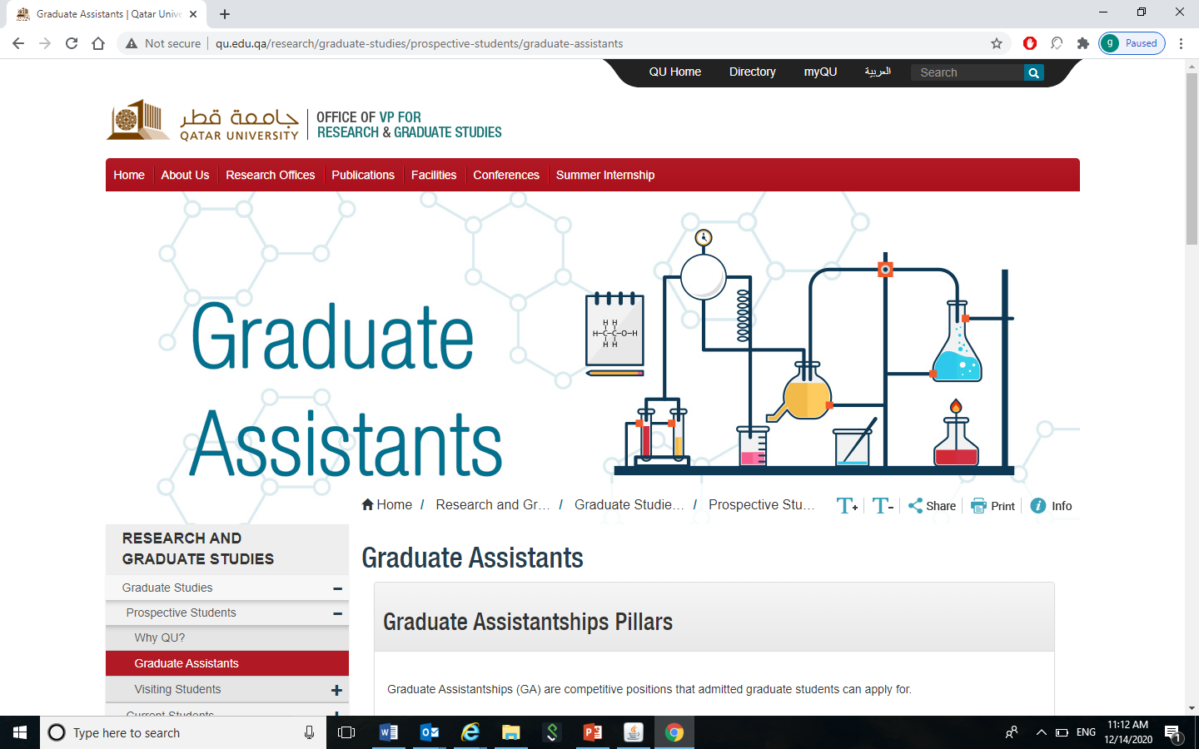
Graduate Assistant (GA)
http://www.qu.edu.qa/research/graduate-studies/prospective-students/graduate-assistants

Slide 68
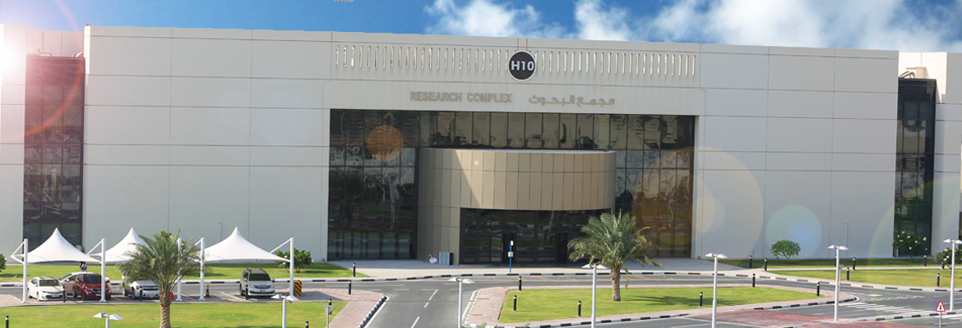
Office of Graduate Studies
We are at Research Building – H 10 , Second Floor , Room # G201
For any question gradstudents@qu.edu.qa

