Slide 1
SESRI
Workshop on
Survey-based
Experiments
Session 5: Methods Experiments (Continued)
April 18, 2017
Doha, Qatar

Slide 2
Outline: Session 5
Continuation of the discussion of methodological experiments within the TSE model of the survey process, including adjustments to collected data
By the end of this session, you should have an understanding of how methodological experiments can improve measurement in your surveys

Slide 3
Outline: Session 5
Continuation of experimental methods examples:
  Interviewer effects
  Incentive experiments
  Adjustment error
  Nonresponse error
  Adaptive/responsive designs

Slide 4
TSE Model: Interviewer Effects
The literature has many examples of observed differences in responses related to interviewer characteristics (gender, race, training, seniority, etc.)
But there are fewer examples of experiments with assignment of interviewer characteristics

Slide 5
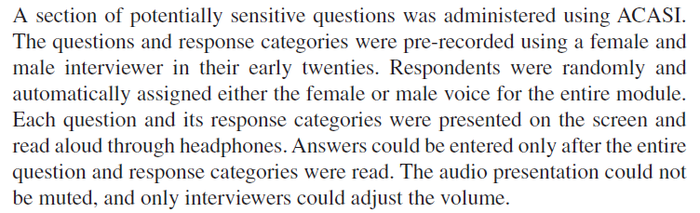
TSE Model: Interviewer Effects
Dykema et al. (2012) studied 776 youth with out-of-home care in four Midwestern states who were between 17 and 17 ½ years of age. All female interviewers.
Topics: fights, stealing, drug use, arrests etc. (28 total)

Slide 6
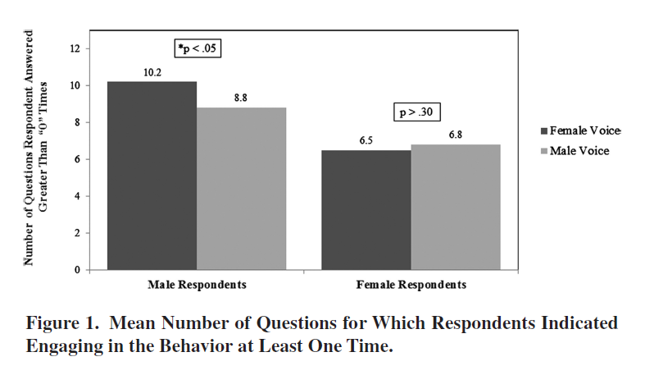
TSE Model: Interviewer Effects
Male respondents answered more questions about behaviors to the female voice, with no difference for female respondents.
Dykema et al (2012)

Slide 7
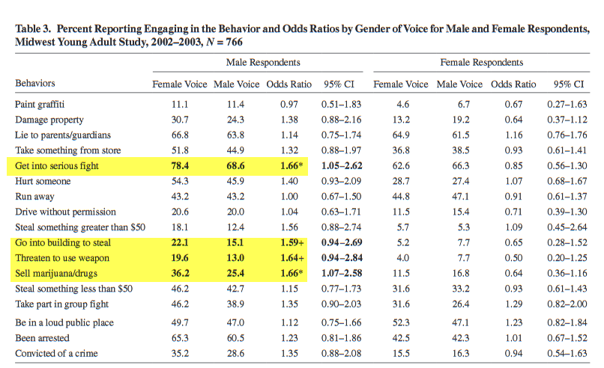
TSE Model: Interviewer Effects
For four items, male respondents were more likely to report behaviors to the female voice, with no difference for female respondents.
Dykema et al (2012)

Slide 8
TSE Model: Incentive Experiments
Incentives are inducements provided to respondents to encourage them to participate in a survey
Can be provided before or after participation or along the way
  Cash
  Gifts
  Lottery chances

Slide 9
TSE Model: Incentive Experiments
Intended effects of incentives:
Increase contact and cooperation
Increase response rates (cross-section and panels)
Improve sample representativeness
Singer & Ye (2013)

Slide 10
TSE Model: Incentive Experiments
National Adult Literacy Survey (NALS) Field-Test
Randomly assigned incentives of $0, $20, & $35 to segments
  Summary of response rates by incentive levels
Incentive | $0 | $20 | $35
Screener | 87.4% | 87.7% | 90.0%
Background | 78.6% | 82.7% | 84.4%
Exercise | 92.8% | 97.9% | 98.0%
Overall | 63.75% | 71.0% | 74.4%
Berlin et al (1992)

Slide 11
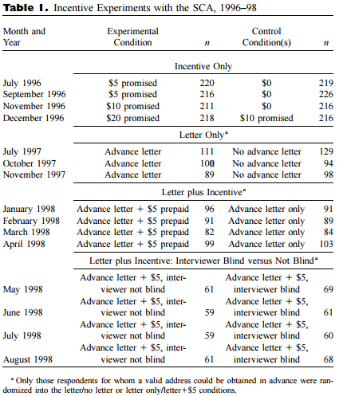
TSE Model: Incentive Experiments
How complicated can incentive experiments get?
Singer, Van Hoewyk & Maher (2000)

Slide 12
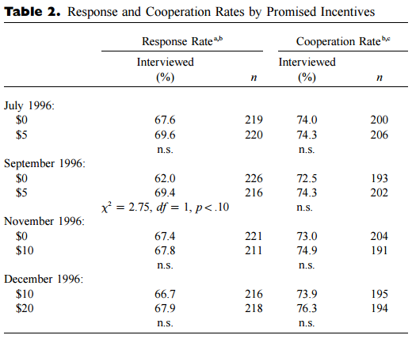
TSE Model: Incentive Experiments
Ultimate results
Singer, Van Hoewyk & Maher (2000)

Slide 13
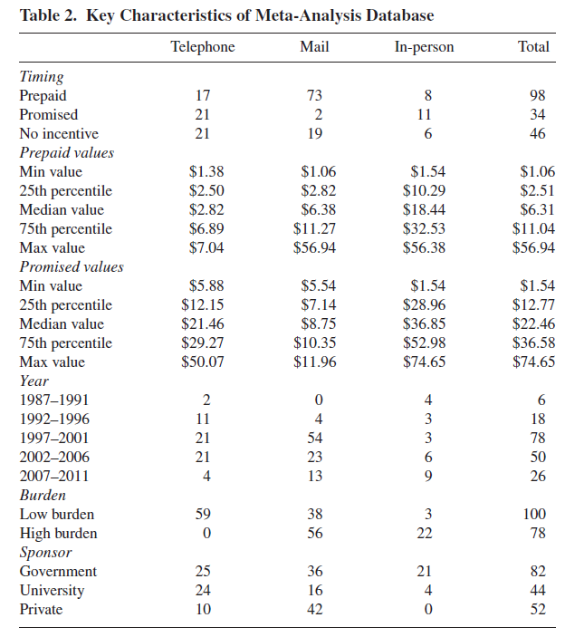
TSE Model: Incentive Experiments
Mercer et al (2015) N = 178 Studies
Notes:
Notice the number of variables describing the study differences
All $$ amounts were converted to 2012 values

Slide 14
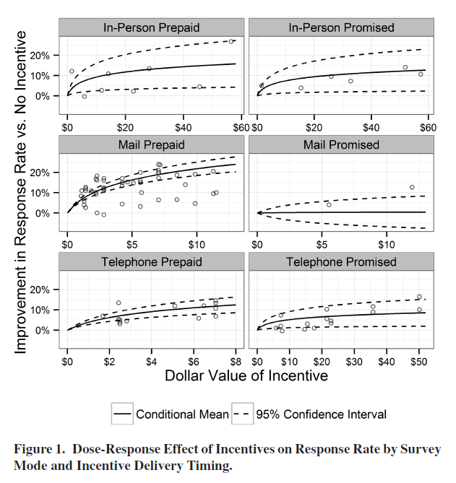
TSE Model: Incentive Experiments
Mercer et al (2015) N = 178 Studies
Notes:
Notice the Y axis values are the same (Improvement in the response rate) but the X axis values change
Prepaid works better than promised for In-person and Mail, but no difference on telephone

Slide 15
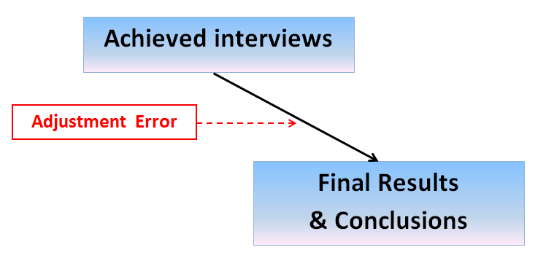
Experiments in Adjustment Error
Weighting
Imputation
Propensity scores

Slide 16
TSE Model: Nonresponse Adjustments
Extensive German panel study “Labor Market and Social Security” (PASS) with N = 14,457 households
Two variables of interest:
Does anyone in the household receive unemployment benefits (UB)?
What is the household income, by category?

Slide 17
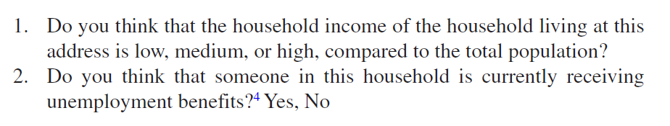
TSE Model: Nonresponse Adjustments
Two pieces of information from interviewers:
Sinibaldi, Trappmann & Kreuter (2014)

Slide 18
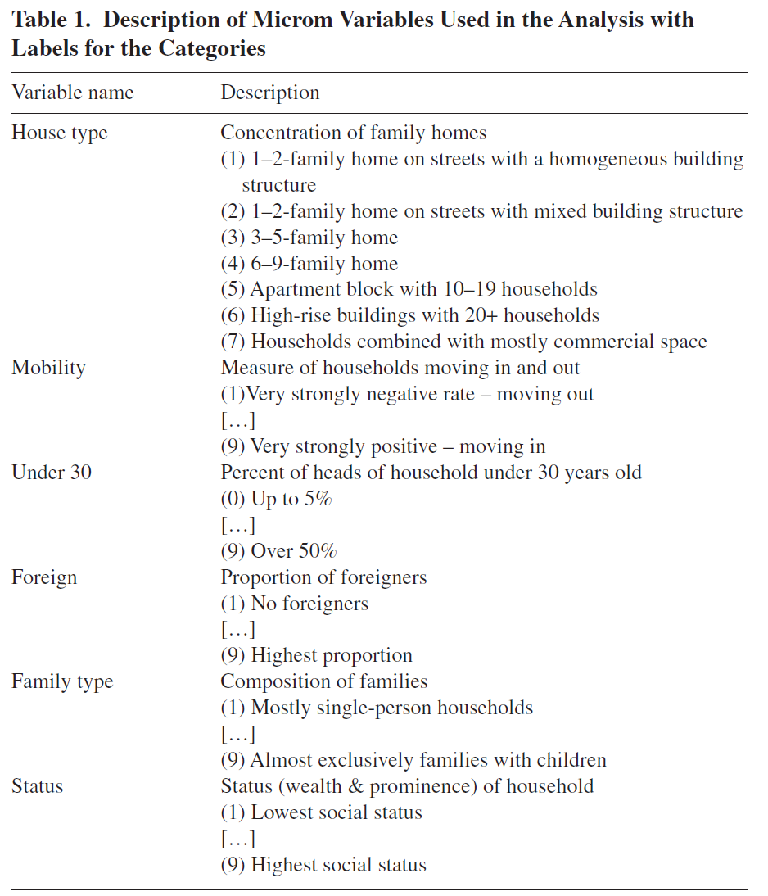
TSE Model: Nonresponse Adjustments
Commercially available data:
Sinibaldi, Trappmann & Kreuter (2014)

Slide 19
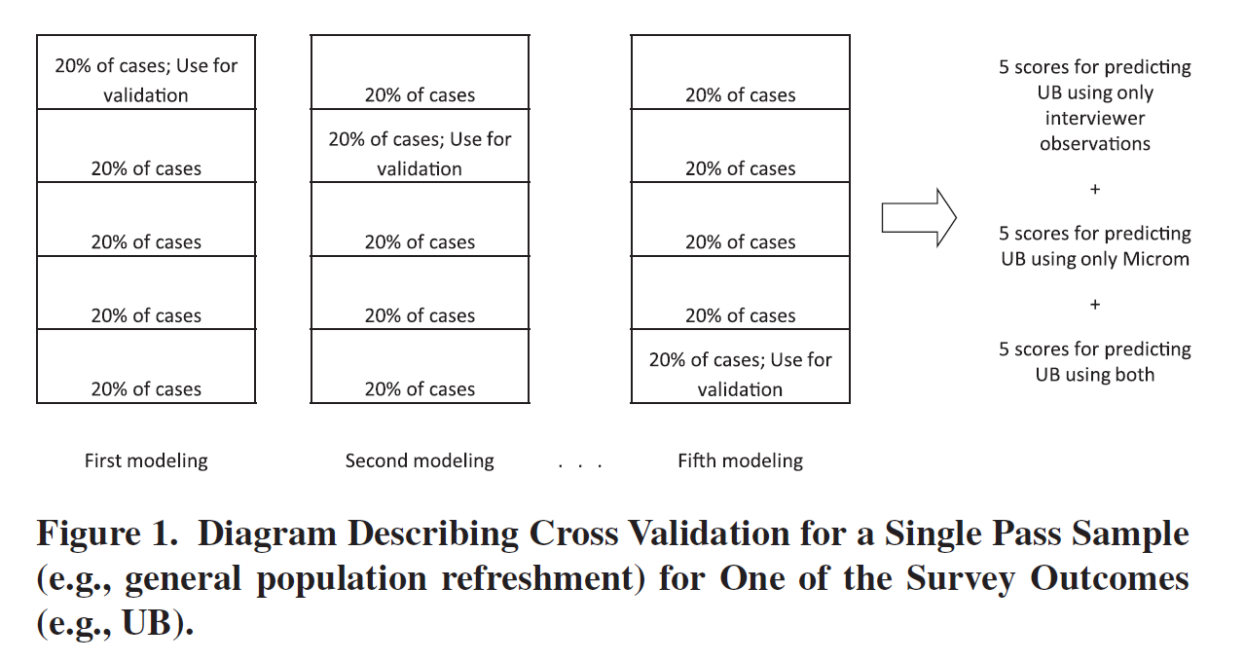
TSE Model: Nonresponse Adjustments
Experimental design for nonresponse adjustment for unemployment benefits (UB)
Sinibaldi, Trappmann & Kreuter (2014)

Slide 20
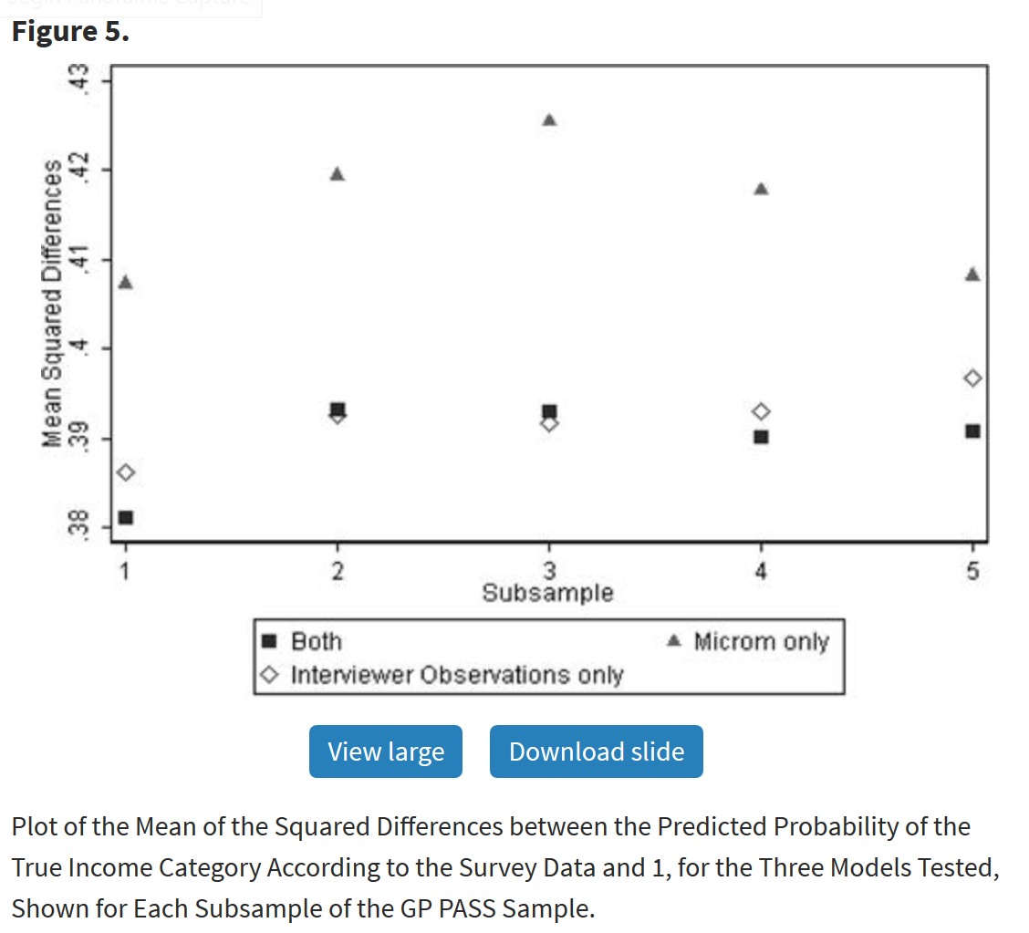
TSE Model: Nonresponse Adjustments
Ability to predict income values
Sinibaldi, Trappmann & Kreuter (2014)

Slide 21
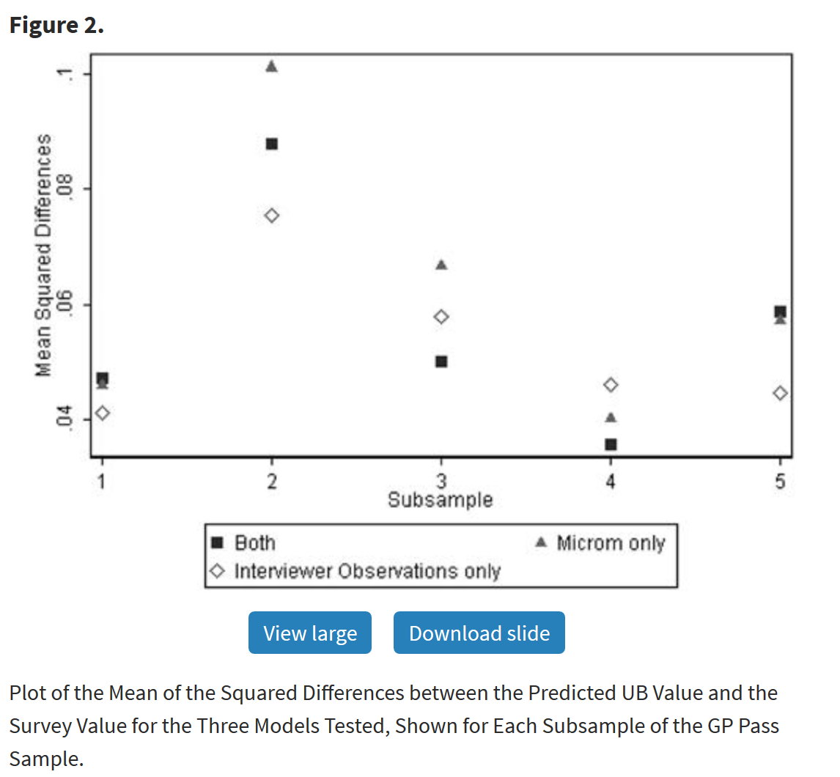
TSE Model: Nonresponse Adjustments
Ability to predict unemployment benefits (UB)
Sinibaldi, Trappmann & Kreuter (2014)

Slide 22
TSE Model: Adaptive/Responsive Designs
An area in which there has been virtually no experimentation
Emphasis is on tradeoffs between survey costs and error
For a fixed amount of money, how can response rates be maximized?
With one week left in the field period, who should be called to maximize the increase in interviews?

Slide 23
TSE Model: Adaptive/Responsive Designs
One interesting question involving panel studies is how to maximize response rates for the next wave
Can a targeted letter, based upon known attributes of sample members, do better than a general letter, i.e. among low propensity to respond interviewees?
Experiment conducted in Wave 6 of the Understanding Society Innovation Panel (UK) in 2013 (Lynn 2016)

Slide 24
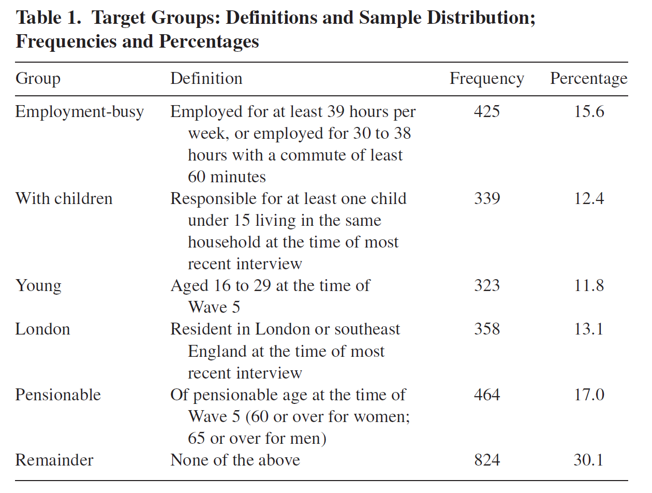
TSE Model: Adaptive/Responsive Designs
Basic study design
Lynn (2016)

Slide 25

TSE Model: Adaptive/Responsive Designs
Sample treatments
Lynn (2016)

Slide 26
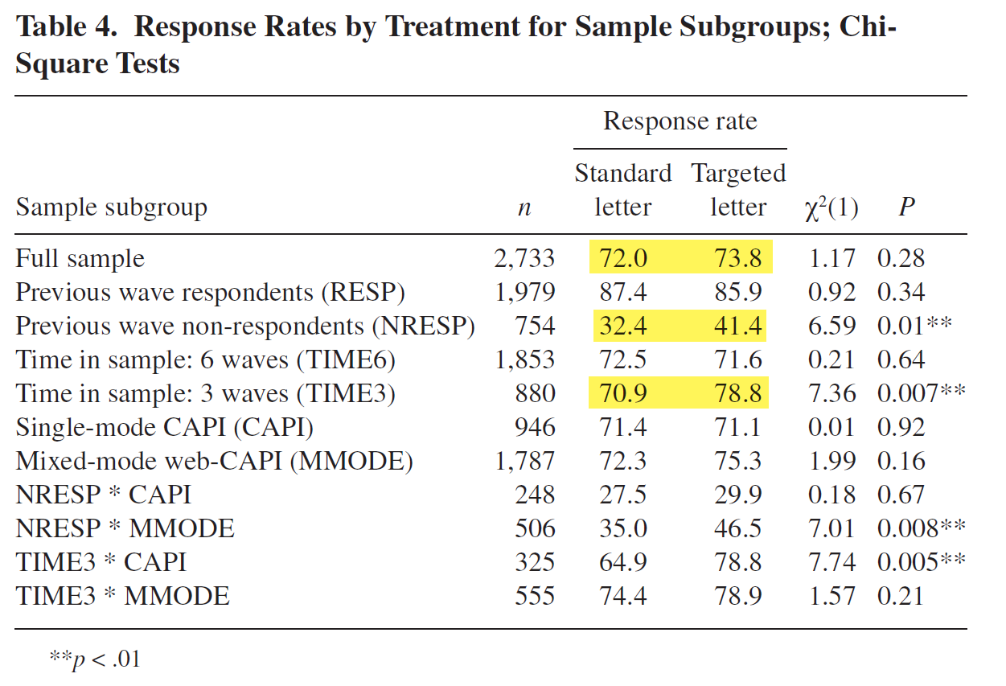
TSE Model: Adaptive/Responsive Designs
Generally weak results with some significant interactions
Lynn (2016)

Slide 27
Other Important Issues with Panels
Experiments could be conducted to test for:
Measurement reliability for individual items
Inter-item and item-total reliability
Dimensionality of multi-item scales

Slide 28
Clicker Question 6
Which of the following is the main tradeoff in adaptive/responsive designs?
  Incentives-nonresponse
  Survey costs-error
  Oversample-weighting
  Panel survey-attrition

