Slide 1
SESRI
Workshop on
Survey-based
Experiments
Session 7: Substantive Experiments (cont.)
April 19, 2017
Doha, Qatar

Slide 2
Outline: Session 7
Continue examples of substantive survey experiment approaches
Notes:
What kinds of resources and assistance to seek and where; we will give you vocabulary to be able to discuss issues around program evaluation.

Slide 3
Vignette Experiments
Vignettes are descriptions of people, situations, or scenarios that have multiple factors or dimensions. Similar to framing experiments, but often they contain many factors.
In vignette experiments, the researcher varies the factors in the vignettes provided to experimental subjects.
Advantage: allows the researcher to observe how multiple factors interact
Disadvantage: number of interactions/treatments can increase quickly

Slide 4
Vignette Example:
Internet Privacy
Study: Martin and Shilton, 2016. “Why Experience Matters to Privacy,” Journal for the Association of Information Science and Technology.
Question: how does consumers’ experience impact context-dependent privacy expectations for mobile applications?
Approach: generated ~77,000 vignettes based on random combinations of five factors
Sample: 1,925 Mechanical Turk respondents
Hypothesis: more frequent app users will rely less on general privacy expectations and more on contextual factors in judging whether privacy policies meet their expectations

Slide 5
Vignette Example:
Internet Privacy
Five factors
  Frequency of use
  Context (games, weather, social networking, navigation, music, banking/finance, shopping/retail, productivity)
  Data collector (app developer, mobile phone provider, third party)
  Info type (location, accelerometer, demographic, images, keywords, name, friends, contact lists)
  Transmission principles (how the data are reused or stored, whether used to target ads or track users)
Produced ~77,000 random combinations of factors

Slide 6
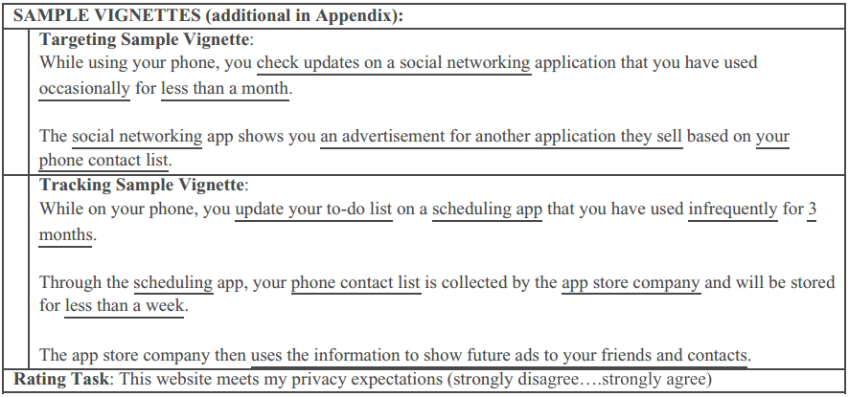
Sample Vignettes
Martin and Shilton (2016)

Slide 7
Vignette Screenshot
Martin and Shilton (2016)

Slide 8
Vignette Example:
Internet Privacy
Dependent variables
  General privacy preferences: “In general, I trust mobile applications” (7 points, strongly disagree to strongly agree)
  Vignette ratings: “This website meets my privacy expectations” (7 points, strongly disagree to strongly agree)
Mediating variable: frequency of usage
Control variables: respondent characteristics

Slide 9
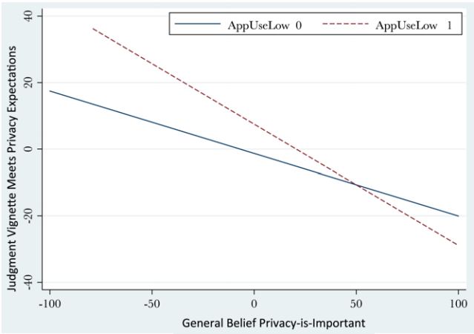
Result: low-frequency users rely more on general privacy beliefs than context-specific factors
Martin and Shilton (2016)

Slide 10
Vignette Example:
Internet Privacy
Implications: overall, study participants are not satisfied with typical privacy practices
Limitations
  Operationalization (response options may not fully capture respondents’ dismay over the policies described in the vignettes).
  Generalizability (non-representative sample)
  Other

Slide 11
Clicker Question 10
Indicate which you believe is the most important limitation of the Martin and Shilton study:
  Operationalization (response options may not fully capture respondents’ dismay over the policies described in the vignettes).
  Generalizability (non-representative sample)
  Other

Slide 12
Conjoint Analysis
Technique developed in the field of market research. Allows researchers to assess the importance of multiple factors in a person’s choice.
Respondents asked to choose between two or more options, which may vary on some or all of the factors.
Various statistical techniques can be used to analyze the data.

Slide 13
Conjoint Example:
EU Bailouts
Study: Bechtel et al., 2015, “Policy Design and Domestic Support for International Bailouts,” working paper.
Question: is opposition to financial bailout of failing Eurozone countries conditional on characteristics of the bailout package?
Hypotheses: support will be affected by cost, burden-sharing, conditionality, and endorsements
Approach: representative online sample of 4,655 German adults, fully randomized conjoint design

Slide 14
Conjoint Example:
EU Bailouts
Design: values of seven factors randomly assigned to create bailout profiles. Each respondent asked to indicate whether they would support each proposal.

Slide 15
Conjoint Example:
EU Bailouts
Figure 1: Conjoint Experimental Design
 | Scenario 1 | Scenario 2
Germany’s contribution to the bailout | 418 bn € | 123 bn €
Germany’s share of the bailout | 19% | 27%
Haircut for private investors | 50% | 30%
Conditions for receiving country | 5% cut in public expenditures | 15% cuts of public sector jobs
Bailout endorsed by | Bundesbank | European Central Bank
Receiving country | Greece | Ireland
Note: Figure illustrates experimental designs for the conjoint analysis.
Bechtel, Hainmueller, Margalit (2014)

Slide 16
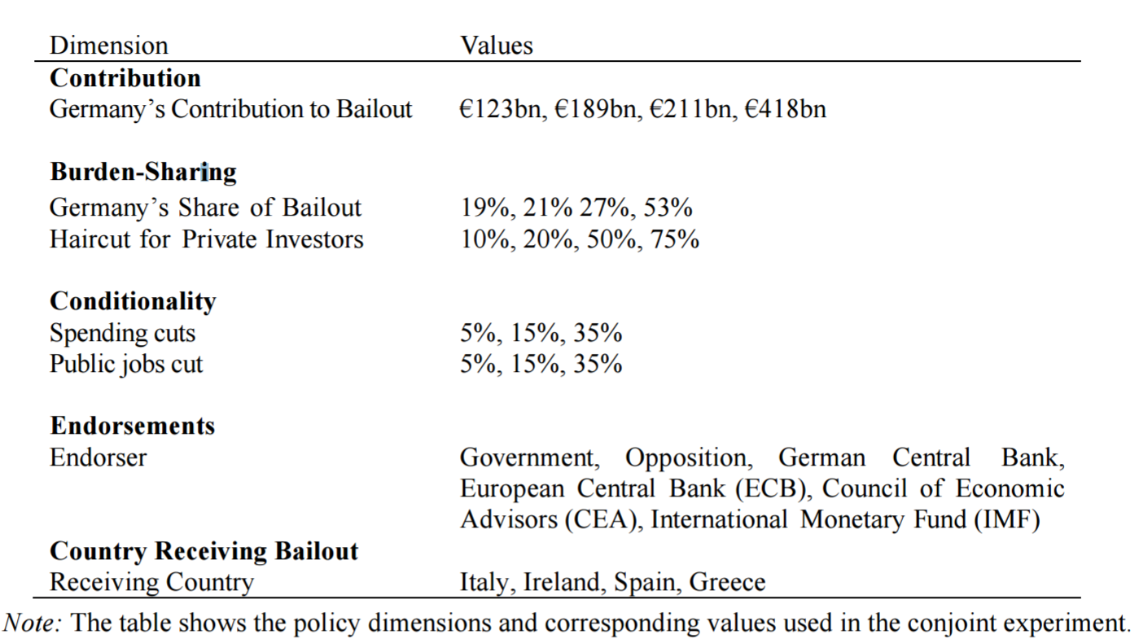
Policy Dimensions & Values for the Bailout Conjoint Experiment
Bechtel, Hainmueller, Margalit (2014)

Slide 17
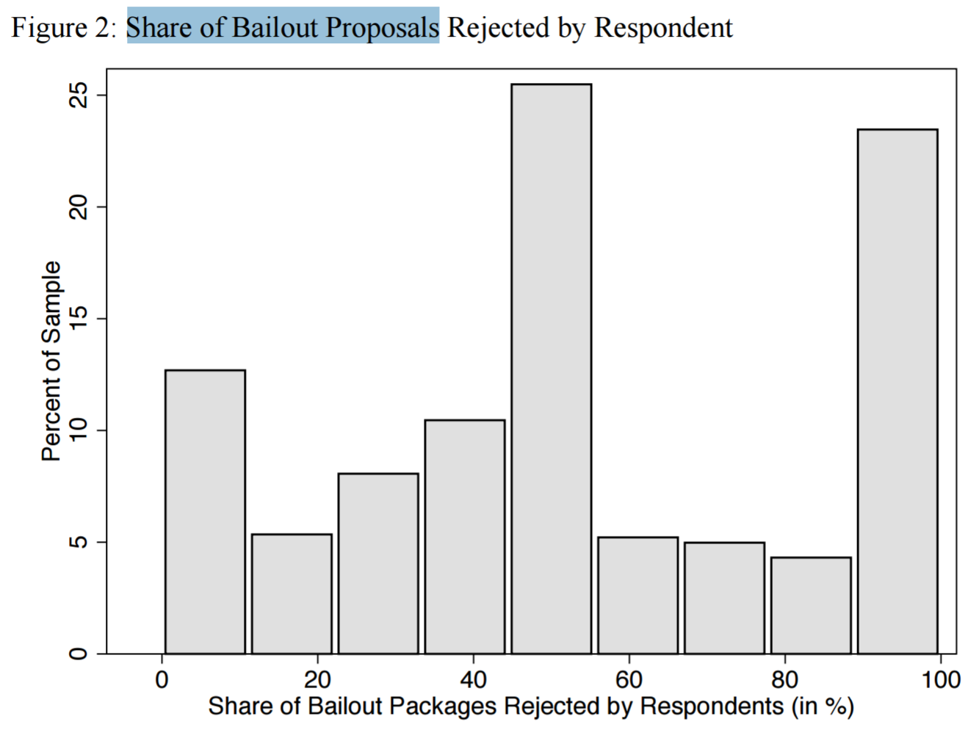
Results: most respondents hold conditional preferences
Bechtel, Hainmueller, Margalit (2014)

Slide 18
Results: financial considerations have the largest marginal effects
Cost to Germany and share covered by Germany have the largest marginal effects on opposition to bailout packages

Slide 19
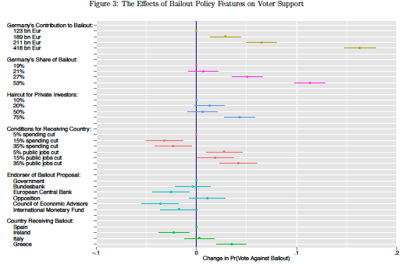
Bechtel, Hainmueller, Margalit (2014)

Slide 20
Conjoint Example:
EU Bailouts
Implications: efficient method for identifying the importance of a large set of factors on individual choice
Limitations
  External validity (vignette factors may not capture relevant dimensions)
  Measurement error (respondents may have limited information)
  Other?

Slide 21
Clicker Question 11
Indicate which you believe is the most important limitation of the Bechtel et al. study:
  External validity (vignette factors may not capture relevant dimensions)
  Measurement error (respondents may have limited information)
  Other

Slide 22
List Experiments
Methodology often used to elicit responses to sensitive questions.
Treatment group views a list of non-sensitive questions, asked to report how many they support or agree with.
Control group views same list of non-sensitive questions with one sensitive question added, also asked how many they agree with.
Compare % supported between treatment and control groups as an estimate of support in the population.
Allows aggregate comparisons.

Slide 23
List Experiment: Voter Turnout
Study: Holbrook and Krosnick, 2010. “Social Desirability Bias in Voter Turnout Reports.” POQ
Question: what percent of respondents turned out to vote in the 2000 US Presidential Election?
Challenge: survey respondents frequently over-report their turnout
Approach: two list experiments with 4/5 items (one phone, one internet), compared to direct turnout question.
Hypothesis: biased reports of turnout less likely when response is anonymized.

Slide 24
List Experiment: Voter Turnout
Two studies
  1) Telephone sample of 898 nationally representative adults
    Three experimental conditions
      One third asked whether they turned out in previous presidential election
      One third asked how many of four political activities they did
      One third asked how many of same four plus voting in last election
  2) Same design but with an internet sample of 1175 adults

Slide 25
List Experiment: Voter Turnout
Holbrook and Krosnick (2010)

Slide 26
Results: Large Mode Effects
Directly reported turnout in the telephone survey was significantly higher than the turnout rate that was inferred from the list comparison.
Directly reported turnout in the internet survey was not statistically different from the turnout rate inferred from the list comparison.

Slide 27
List Experiment: Voter Turnout
Implications: many applications in which respondents are more likely to truthfully reveal sensitive information
Limitations
  Inferential limitations (method does not allow individual-level inferences)
  Comparisons (two studies use different samples)
  Other?

Slide 28
Clicker Question 12
Indicate which you believe is the most important limitation of the Holbrook & Krosnick study:
  Inferential limitations (method does not allow individual-level inferences)
  Comparisons (two studies use different samples)
  Other

