Slide 1

Development of Instrumentation for High-Precision Position Measurement
Senior Design Project
30/12/2015
Done by:
Mohamed El-Jaam
Sharief Saleh
Asem Khattab
Mahmoud Mesleh
Supervised by:
Prof. Mohieddine Benammar
Dr. Faycal Bensaali

Slide 2
Outline
Introduction
Types of Rotary Sensors
Converters
Qatar University Contribution
Design Objectives and Constrains
Proposed PST Method
Simulation
Hardware Implementation
Achievements
What’s next?!

Slide 3
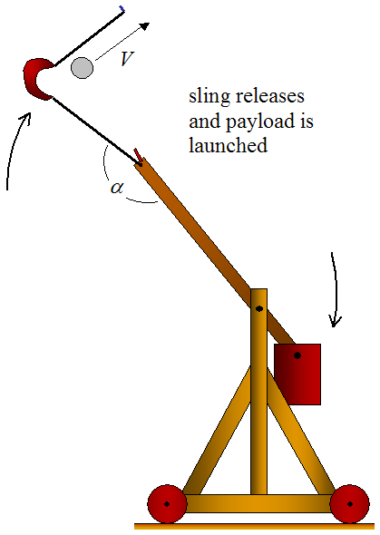


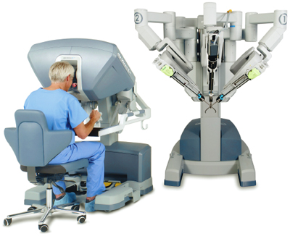
Importance and Applications
In the past:
  No feedback
  Manually controlled
  Inaccurate and inefficient
In the present:
  Feedback system
  Rotary sensors
  Very High accuracy
1km
1003.5m
1km
θ = 45.1
θ = 45.0

Slide 4
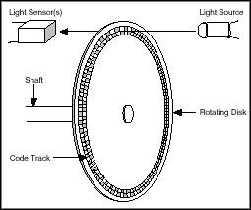
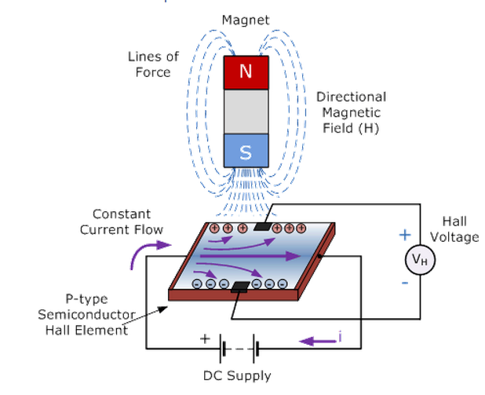
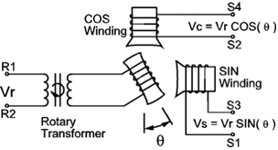
Types of rotary sensor
None trigonometric rotary sensor
  Optical rotary encoder
Trigonometric rotary sensor
  Hall Effect sensor
  Resolvers

Slide 5
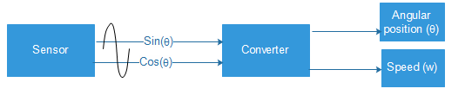
What is meant by converters?
Inputs and Outputs

Slide 6
Types of converters
Open loop
Cos(θ)
Input
Sin(θ)
System
θ
Output

Slide 7
Types of converters
Closed loop
Cos(θ)
Input
Sin(θ)
System
θ
Output
+
-
Feedback
Error

Slide 8
Qatar University is Leading This Field!
Tens of published papers in this field have been produced by the faculty of the EE department of Qatar University since 2004
Many novel methods were described in these papers and considered valuable references and inspiration for many new methods
Almost every new research in the area cites one or more of these paper.
Among the active professors in the field are Prof. Mohieddine Benammar and Prof. Lazhar Ben Brahim
We are proud to be a part of this journey of contribution to human knowledge

Slide 9
Design Objectives and Constraints
The converter should be implemented digitally
The converter should be an open loop converter
The error of the converter must be less than 0.01º
The converter must be independent of the amplitude of the SCS (Sine and Cosine Signals) as long as both amplitudes are equal
To meet these objective, we designed a novel converter…

Slide 10
Introducing
The Phase Shifted Tan Method (PST)

Slide 11
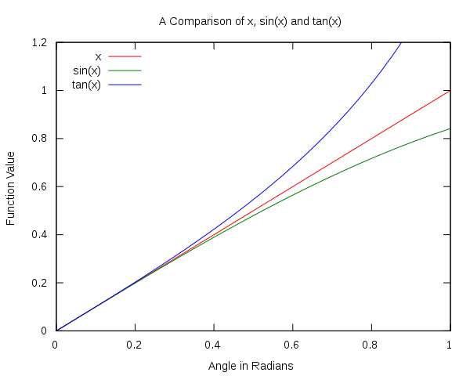
What is the PST Method?
A novel open loop converter that depends on the pseudo-linearity of the tangent function
CC BY-SA 3.0

Slide 12
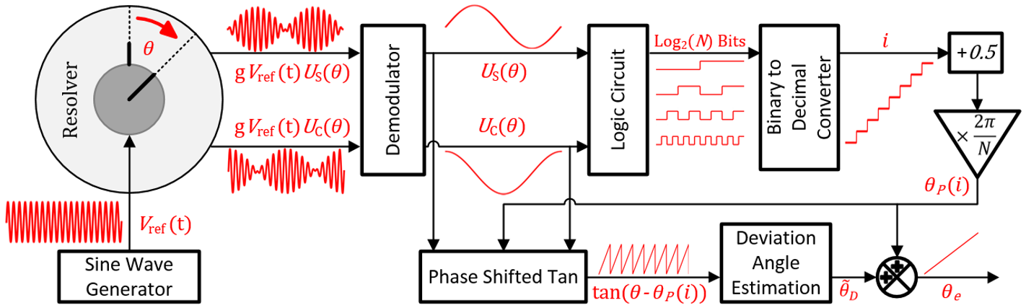
PST Method, The Big Picture

Slide 13
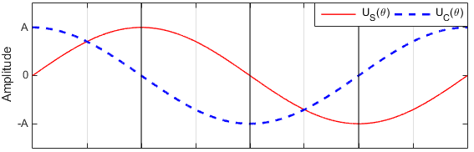
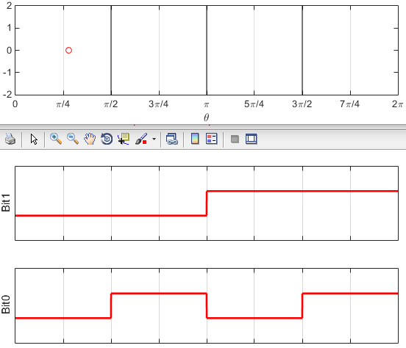

PST in Simple Steps
Step One: Locate the input angle in one of N equal-length segments in the [0 , 2π] interval using a logic circuit
Example: let N=4, the section number $i$ is directly calculated from Bit 1 and Bit 0

Slide 14
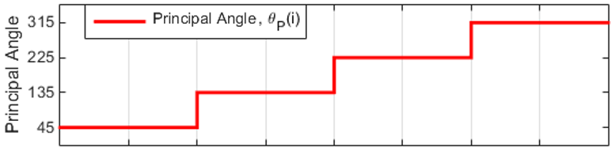

PST in Simple Steps
Step Two: Calculate the Principal Angle $θ_{P}\left(i\right)$, which is the middle point of each section, using simple mathematical relationship:
$$θ_{P}\left(i\right)=2\left(i+0.5\right)π/N ; i=0,1,2 . . . , N−1$$
7π/4
5π/4
3π/4
π/4

Slide 15
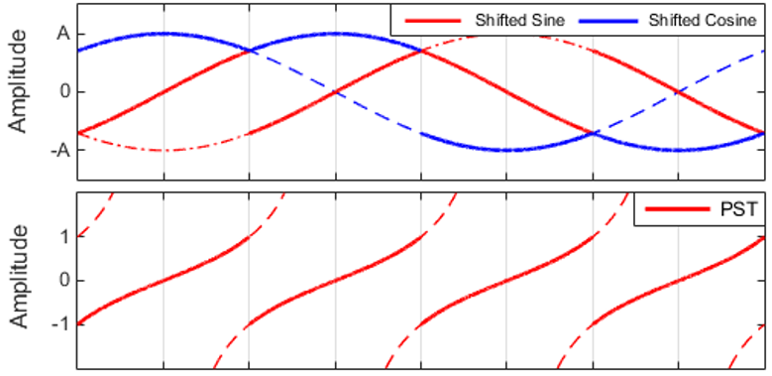

PST in Simple Steps
Step Three: Shift $\tan\left(θ\right)$ to the principal angle using simple operations on$U_{S}\left(θ\right)$ and $U_{C}\left(θ\right)$:
$$\tan\left(θ−θ_{P}\left(i\right)\right)=\frac{shifted Sine}{Shifted Cosine}=\frac{{\cos{θ_{P}\left(i\right)×}U}_{S}\left(θ\right)−{\sin{θ_{P}\left(i\right)×}U}_{C}\left(θ\right)}{{\sin{θ_{P}\left(i\right)×}U}_{S}\left(θ\right)+{\cos{θ_{P}\left(i\right)×}U}_{C}\left(θ\right)}$$
Note that because of the symmetry of the tangent function, only N/2 PSTs are needed. Note also that the resultant PSTs are independent of the amplitude of the SCS

Slide 16
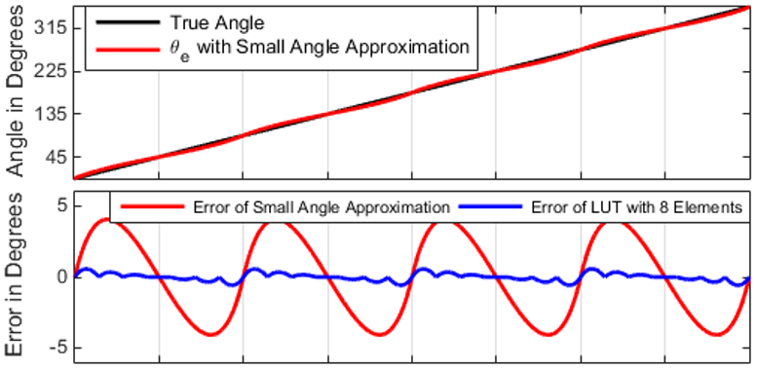

PST in Simple Steps
Step Four: Use the PST to estimate the deviation angle ${\tilde{θ}}_{D}$ utilizing one of two options:
  small angle approximation
  small LUT of the inverse tangent
  Estimated Angle: $θ_{es}=θ_{P}\left(i\right)+{\tilde{θ}}_{D}$

Slide 17
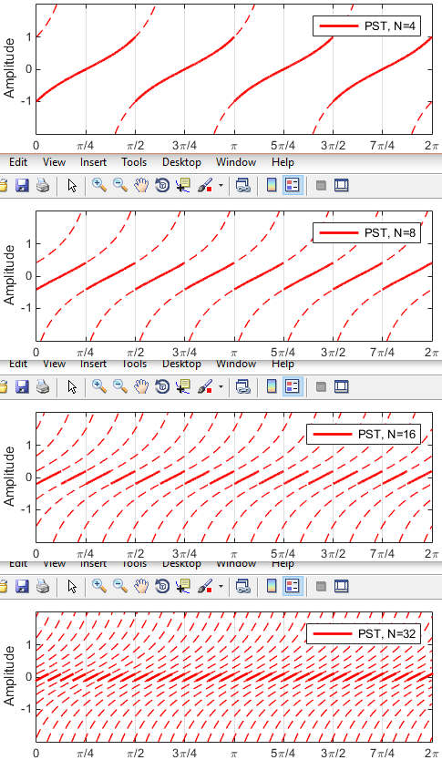
What if the N is increased?
The non-linearity of the PST will decrease and hence the error will be effectively reduced

Slide 18
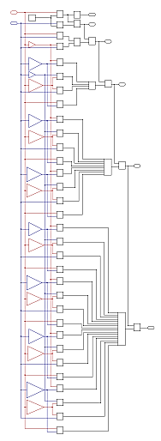

What if the N is increased?
complex logic circuits are needed for high values of N, Example: N=64
A novel algorithm was developed to do the task and produce $\log_{2}\left(N\right)$ bits
Logic circuit for N=64

Slide 19
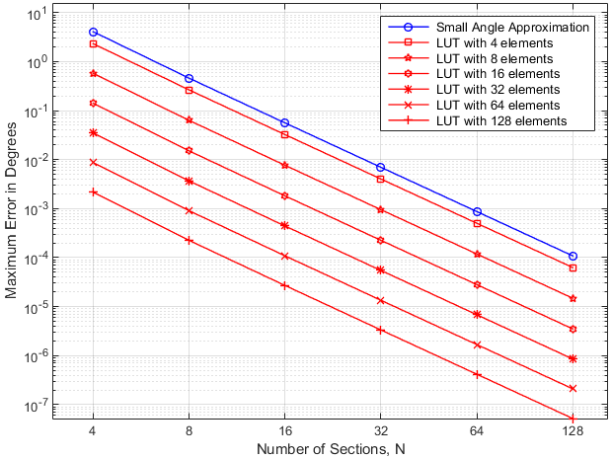
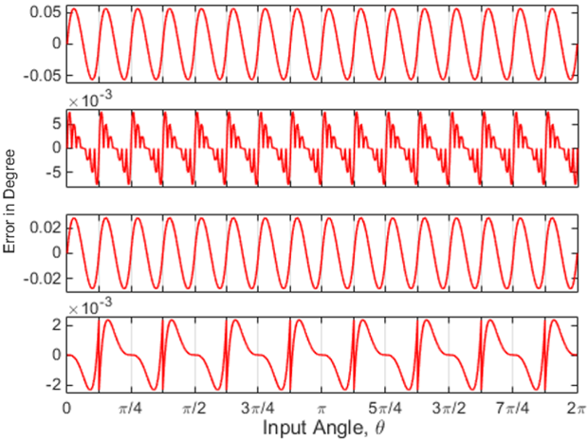
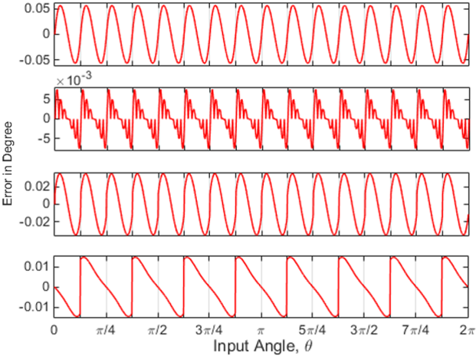
Performance of the PST Method
Maximum Error as a function of the number of sections N
The error in presence of an accurate measurement of the amplitude of the SCS. N=16
The error in presence of 0.1% error in the amplitude of the SCS. N=16

Slide 20
Simulation

Slide 21
Simulation
MATLAB
Simulink
LabVIEW

Slide 22
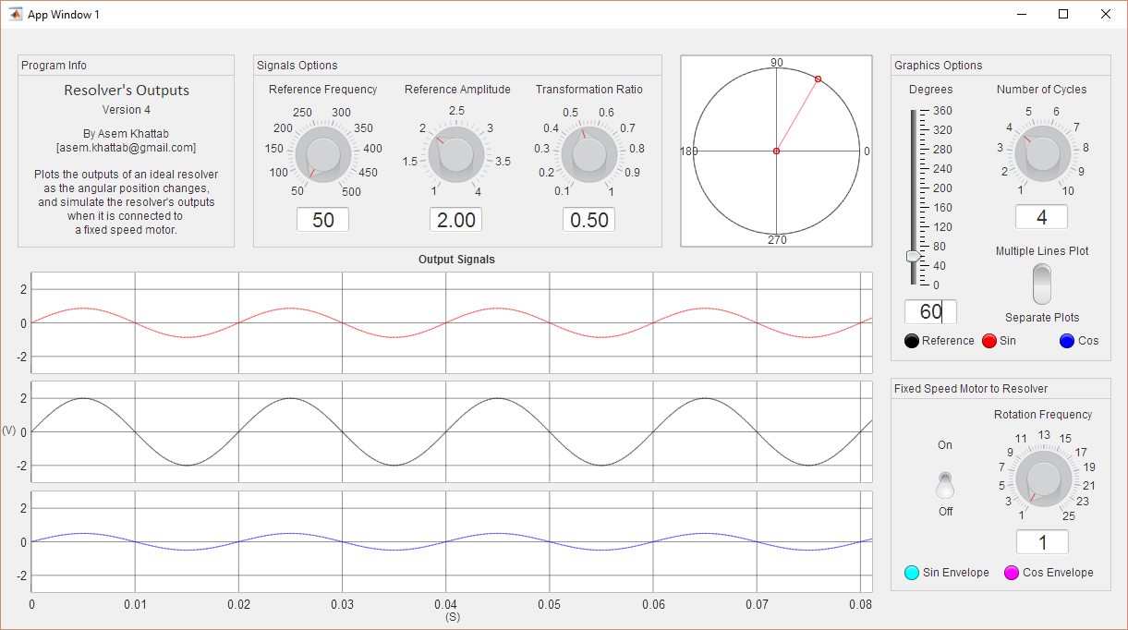
Simulation: MATLAB
Resolver Emulator

Slide 23
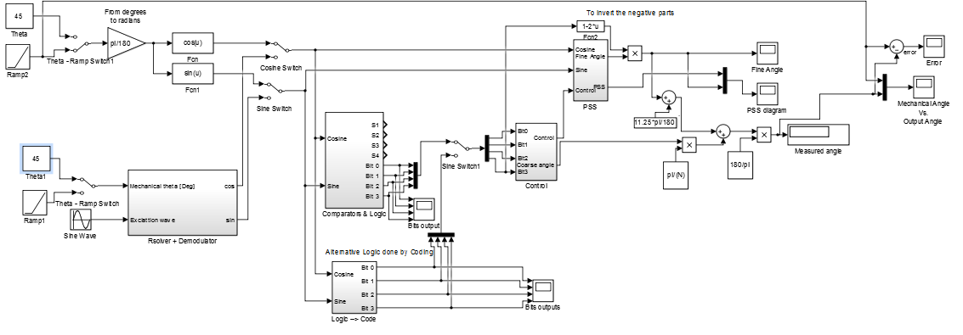
Simulation: Simulink
Version 1

Slide 24
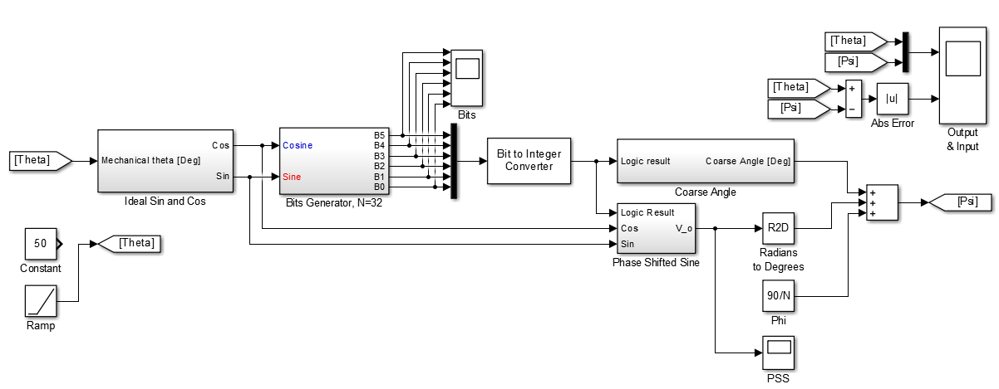
Simulation: Simulink
Version 2
Logic circuit for N=64

Slide 25
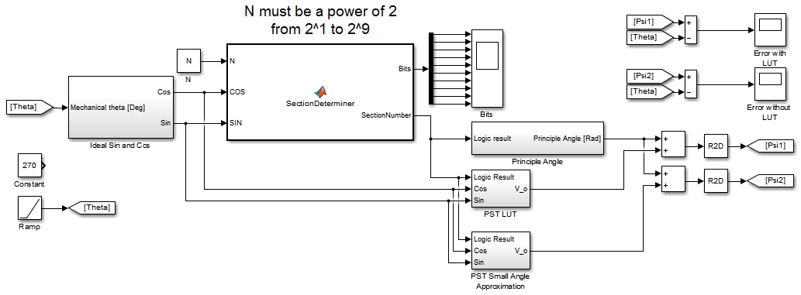
Simulation: Simulink
Version 3

Slide 26
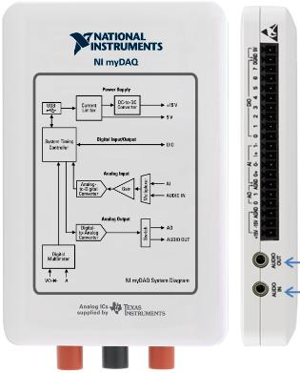
Emulator: LabVIEW
Emulating sinusoidal sensor operating at:
Constant speed
Acceleration condition
Transient condition (Step angle)

Slide 27
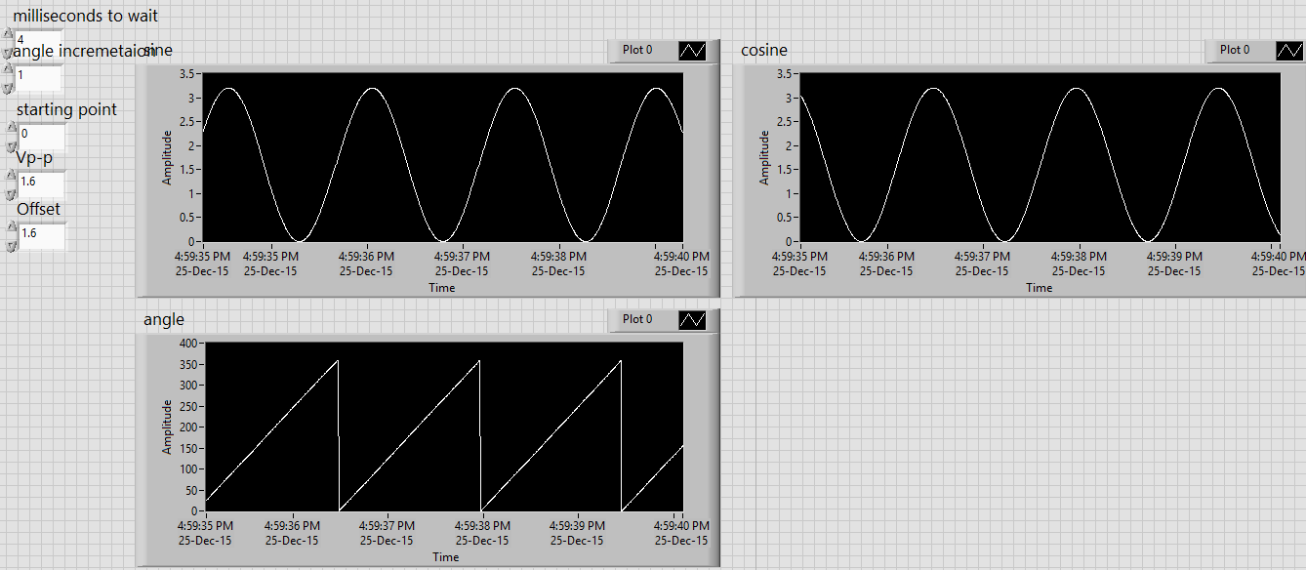
Emulator: LabVIEW
Constant speed emulator

Slide 28
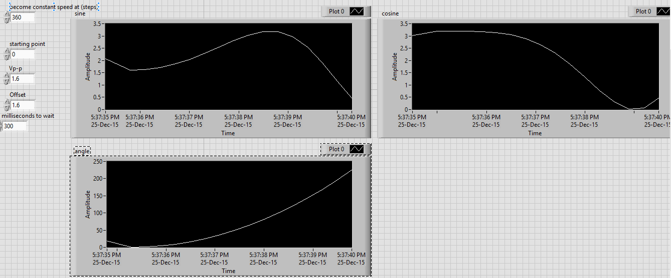
Emulator: LabVIEW
Acceleration emulation

Slide 29
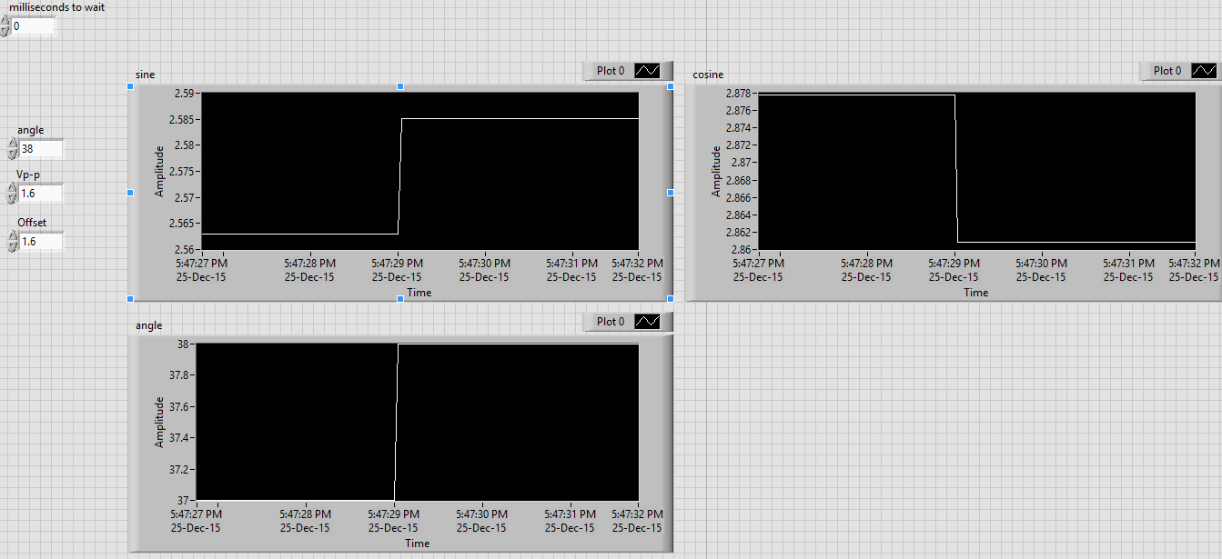
Emulator: LabVIEW
Transient emulation

Slide 30
Hardware
Implementation

Slide 31
Hardware Implementation
The implementation was done on the Arduino Uno R3 & mbed
Arduino was used for testing
Implementation

Slide 32
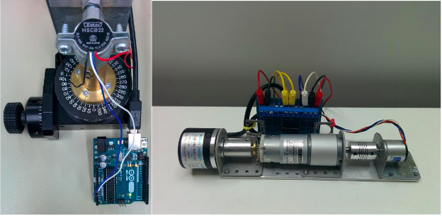
Hardware Implementation
Two practical tests
Equipment used

Slide 33
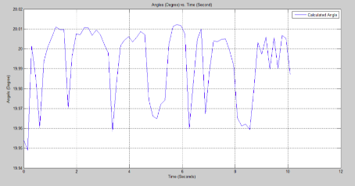
Practical
Accuracy test. (at 20 degrees)

Slide 34
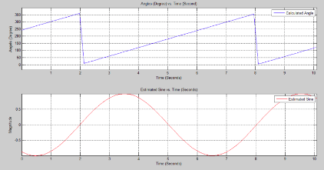
Practical
Dynamic test (at 15 RPM)

Slide 35
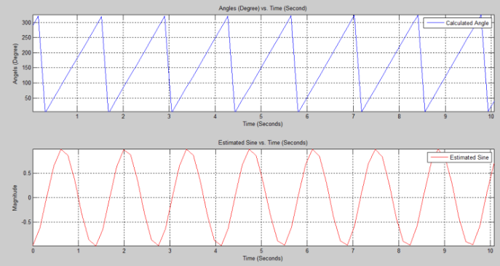
Practical
Dynamic test (at 45 RPM)

Slide 36
Achievements of Phase One of the Project
All the design objectives and constraints have been successfully met
Interdisciplinary knowledge has been acquired and applied it to real life applications. EE courses utilized in this project include:
  Electronics
  Embedded systems
  Sensors and Instrumentation
  Control Systems
Valuable skills were honed, like efficient time management and effective teamwork
A conference paper was submitted to the 2016 IEEE Sensors Applications Symposium, Catania, Italy

Slide 37
What is Next?
Developing signal correction techniques
Doing more dedicated testing for the converter
Using the converter in a closed loop motor control system and assessing its dynamic performance
Writing an IEEE journal paper

