Slide 1


Jean monnet module – Doha courses on European union law – SPRING 2021
Prof. Francis Botchway (Sir William Blair Chair)

Slide 2
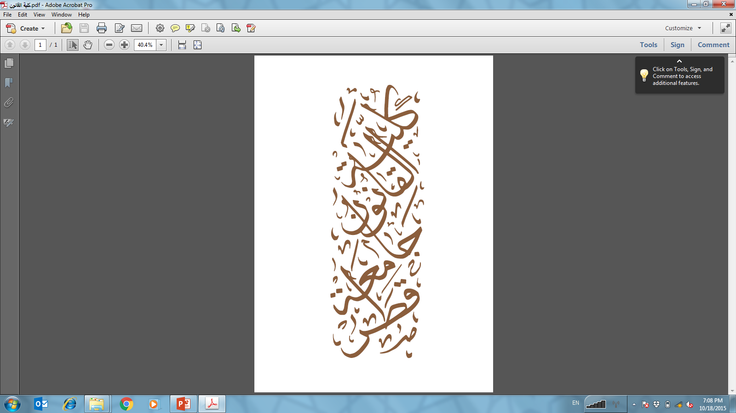




WELCOME TO THE COURSE
Instructor
Prof. Francis Botchway, Sir William Blair Chair in ADR, College of Law, Qatar University
Ph.D. – University of Manchester, UK.
LL.M. – Harvard Law School, USA.
LL.M. – Dalhousie Law School, Canada.
LL.B./B.L. – University of Ghana Law School.

Slide 3

WELCOME TO THE COURSE
Contact Details
Email:fbotchway@qu.edu.qa
Office: College of Law Building I09, Office B359
Office Hours: Monday, 11:00AM – 1:30 PM

Slide 4

WELCOME TO THE COURSE
Course Information
Class Days: Tuesday and Thursday
Class Time: 7:00 PM – 8:30 PM
Classes will be held in person in the auditorium of I09

Slide 5

Students
Students
  What is your background?
  Why did you choose this course?
  What are your expectations for this course?

Slide 6
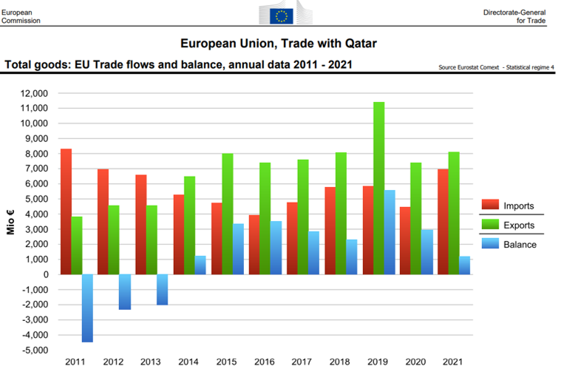
Course 1: Why study EU LAW in Qatar?

Slide 7
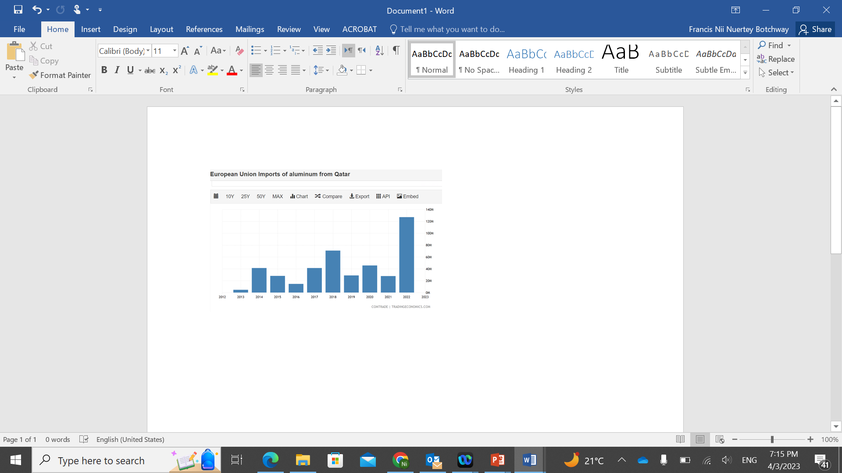


Slide 8

I. Historical Background and Development of the Case Law

Slide 9

Political Relations (Qatar and EU roles in the middle-east)
Social and Cultural relations (tourism, etc).
Sports (Qatari ownership of PSG, Manchester United ?)

Slide 10
EVOLUTION OF EU -EARLY EFFORTS
Holy Roman Empire
Governed by the Pope and Ecclesiastes

Slide 11
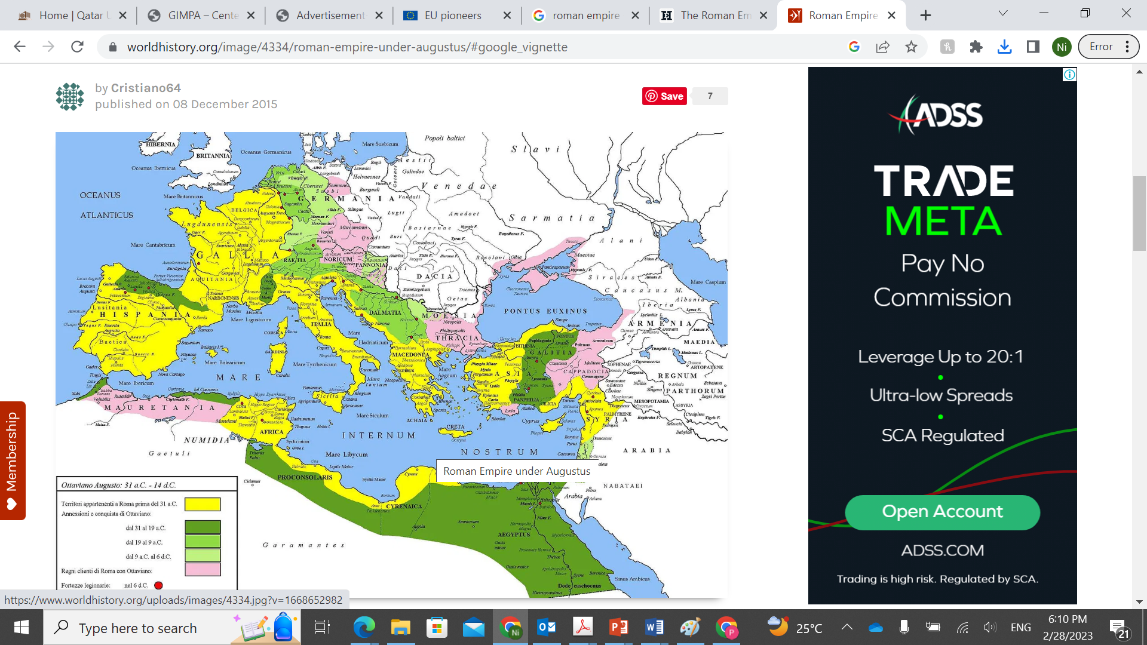

Slide 12
Religious Wars – Alexander the Great
Peace of Westphalia in 1688
Napoleonic Wars
Nazi War
Marshall Plan

Slide 13
Questions?

