Slide 1


Jean monnet module – Doha courses on European union law – Fall 2021
Dr. Ioannis Konstantinidis

Slide 2






WELCOME TO THE COURSE
Instructor
Dr. Ioannis Konstantinidis, Assistant Professor of International Law, College of Law, Qatar University
Ph.D. – Sorbonne Law School/Université Paris 1 Panthéon-Sorbonne, France
LL.M. – Sorbonne Law School/Université Paris 1 Panthéon-Sorbonne, France
M.A. – Institut d’Etudes Politiques de Paris/Sciences Po, France
B.A. – National and Kapodistrian University of Athens, Greece

Slide 3

WELCOME TO THE COURSE
Contact Details
Email: ikonstantinidis@qu.edu.qa
Office: College of Law Building I09, Office B335
Office Hours (via Blackboard Collaborate): Monday, 11:30AM – 12:30 PM

Slide 4

WELCOME TO THE COURSE
Course Information
Class Days: Sunday/Tuesday/Thursday
Class Time: 8:00 PM – 9:00 PM
Classes will be held online via Blackboard Collaborate

Slide 5

Students
Students
  What is your background?
  Why did you choose this course?
  What are your expectations for this course?

Slide 6
Course 2: The Evolution of the European Union Law in the Field of Human Rights – Week 4
I. Historical Background and Development of the Case Law
II. From the 1977 Declaration to the Treaty of Lisbon
III. Concluding Remarks

Slide 7

Week 4
Learning Outcomes: On completion of this week, students should
  Have developed an advanced understanding of the emergence of the European Union's commitment to human rights

Slide 8
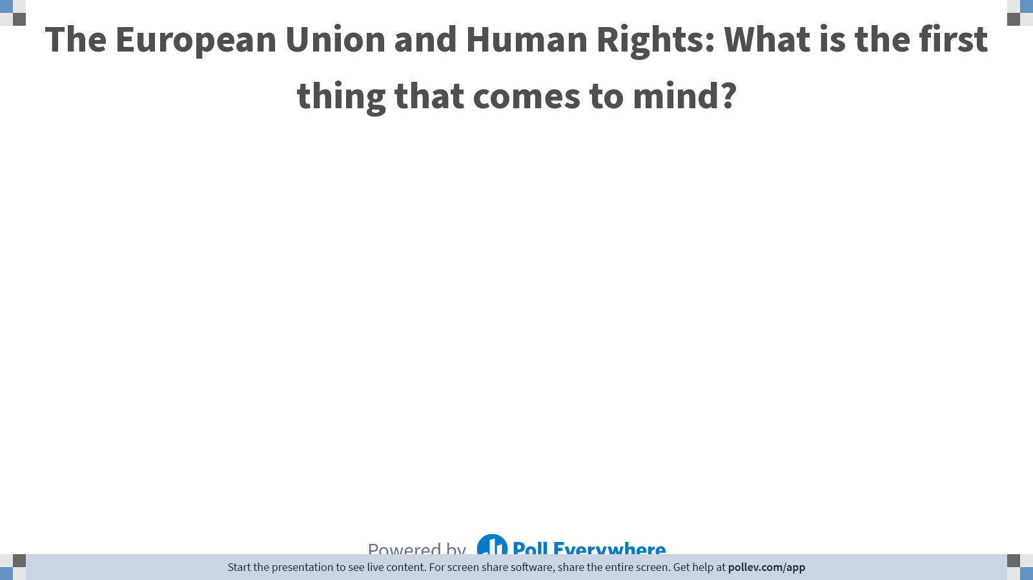
Notes:
Poll Title: Do not modify the notes in this section to avoid tampering with the Poll Everywhere activity.
More info at polleverywhere.com/support
The European Union and Human Rights: What is the first thing that comes to mind?
https://www.polleverywhere.com/free_text_polls/twTQjGgyX4xqanyVQN1Wt

Slide 9

I. Historical Background and Development of the Case Law
The European Union (EU) and Human Rights

Slide 10

I. Historical Background and Development of the Case Law
The Growth of an Idea
  In spite of Article 2 of the Treaty on the European Union (EU), according to which the EU is founded on the value of respect for human rights, human rights were not a pressing concern in the early European Economic Communities (ECC, 1957) (as it then was)

Slide 11

I. Historical Background and Development of the Case Law
The Growth of an Idea
  Why?
  The EEC Treaty started out as an economic treaty, of limited ambitions, with the aim of creating a Common Market. There were no sections on fundamental rights because the EEC founders did not think this relevant to a treaty with mainly economic aspirations

Slide 12


I. Historical Background and Development of the Case Law
The Growth of an Idea
  Why?
  The European Convention on Human Rights and Fundamental Freedoms (ECHR) was also, of course, already in existence, and probably thought sufficient to operate as a ‘Bill of Rights’ for Europe
  The ECHR was promoted by the Council of Europe and NOT by the EU

Slide 13
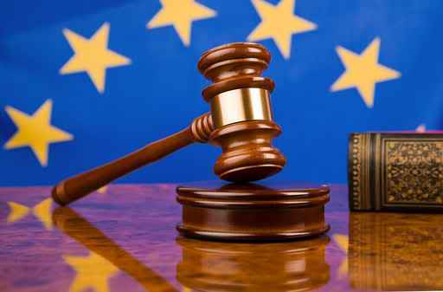
I. Historical Background and Development of the Case Law
The Growth of an Idea
  The fundamental rights gap became all too apparent at a very early stage in the life of the EEC: national courts feared that Member States could use the EEC in order to circumvent the fundamental rights guarantees that had been at the center of the post-war constitutionalizing effort
  If the EEC had been given regulatory powers which could directly affect individuals, and those powers were not curtailed by fundamental rights, then individuals might see their fundamental rights limited beyond what was permissible under their own constitutional arrangements

Slide 14
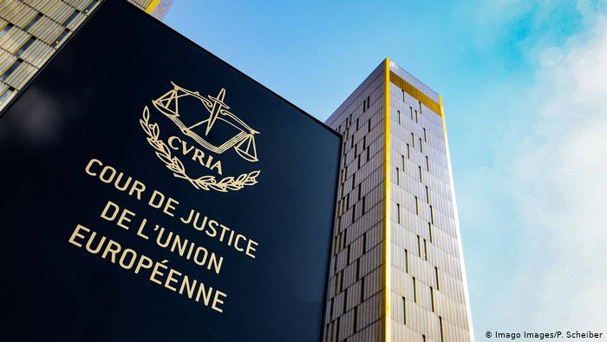
I. Historical Background and Development of the Case Law
The Growth of an Idea
  It did not take long for the Court of Justice of the European Union to find that fundamental rights were part of the ‘”general principles of Community law” which the Court would protect

Slide 15

I. Historical Background and Development of the Case Law
The Growth of an Idea
  In the case of Stauder, Mr. Stauder attacked a European Commission decision which made the distribution of butter at reduced prices conditional upon the identification of the recipient
  He claimed that having to be identified by name breached his right to dignity as protected by the German Constitution. The German court referred a question to the Court of Justice to assess the validity of the Commission’s decision

Slide 16
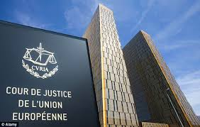
I. Historical Background and Development of the Case Law
The Growth of an Idea
  Having examined different language versions of the Commission’s decision, the Court of Justice found that identification by name was not required by the Community act
  The Court considered fundamental rights unwritten general principles applicable to the acts of the EEC’s institutions

Slide 17

I. Historical Background and Development of the Case Law
The Growth of an Idea
  In subsequent case law the Court clarified that in deciding which fundamental rights formed part of the general principles of the EEC law it would draw inspiration from constitutional traditions common to the Member States and from international treaties for the protection of human rights to which Member States were signatory or had collaborated; of those, the most significant is without doubt the ECHR

Slide 18

II. From the 1977 Declaration to the Treaty of Lisbon
The Response of the Political Institutions
  It is not surprising then that the developments in the case law of the Court met with the approval of the political institutions

Slide 19
II. From the 1977 Declaration to the Treaty of Lisbon
The Response of the Political Institutions
  In 1977, just eight years after the ruling in Stauder and once the case law was ‘settled’, the European Parliament, the Council, and the Commission issued a joint declaration to the effect that they considered themselves bound by fundamental rights as general principles of (then) EEC law

Slide 20
II. From the 1977 Declaration to the Treaty of Lisbon
The Response of the Political Institutions
  After that, every Treaty revision strengthened the protection of fundamental rights in the EU
  In particular, following the expansion of the EU’s competences in the field of asylum, immigration, and criminal law, the protection of fundamental rights in the EU became of paramount importance for many of the Member States

Slide 21
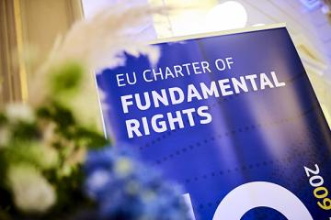
II. From the 1977 Declaration to the Treaty of Lisbon
The Response of the Political Institutions
  The process of codification of the Court’s case law, and the ongoing attention to fundamental rights, culminated in 2000 with the drafting of the Charter of Fundamental Rights of the EU Whilst at first the Charter was ‘merely’ proclaimed by the three political Institutions, almost mirroring the 1977 Declaration, the Lisbon Treaty subsequently gave it the same legal value as the Treaties themselves (Article 6(1) TEU)
  Furthermore, and as we shall see in more detail later, the debate as to whether the Union should become a party to the ECHR has finally received a positive answer and Article 6(2) TEU provides not only the competence for accession but also a legal obligation to do so

Slide 22
II. From the 1977 Declaration to the Treaty of Lisbon
The Response of the Political Institutions
  Article 6(3) of the TEU: “Fundamental rights, as guaranteed by the European Convention for the Protection of Human Rights and Fundamental Freedoms and as they result from the constitutional traditions common to the Member States, shall constitute general principles of the Union’s law”

Slide 23
III. Concluding Remarks
  The Treaty restates the centrality of fundamental rights, the ECHR, and the common constitutional traditions, as general principles of Union law. Article 6(3) therefore allows the Court of Justice to go beyond the rights contained in the Charter, should the need ever arise

Slide 24
III. Concluding Remarks
  Respect for fundamental rights, as well as the other values listed in Article 2 TEU, is a precondition for accession to the EU, and relevant for participation in the EU
  For this reason, Article 7 TEU provides for a procedure to police and react to the risk of serious breaches of those values. In a case in which the Council determines that the breach is serious and persistent, it can suspend certain rights, including voting rights, of the Member State in question

Slide 25
Next Week: The EU Charter of Fundamental Rights
  ­Readings
  Per the course syllabus

Slide 26
Questions?

