Slide 1

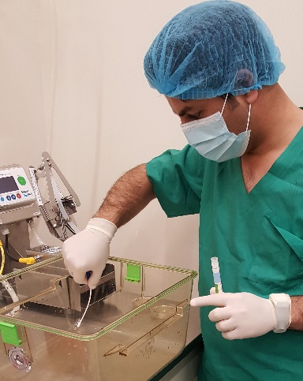
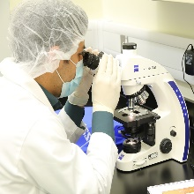
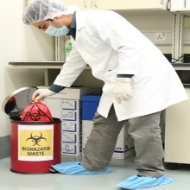
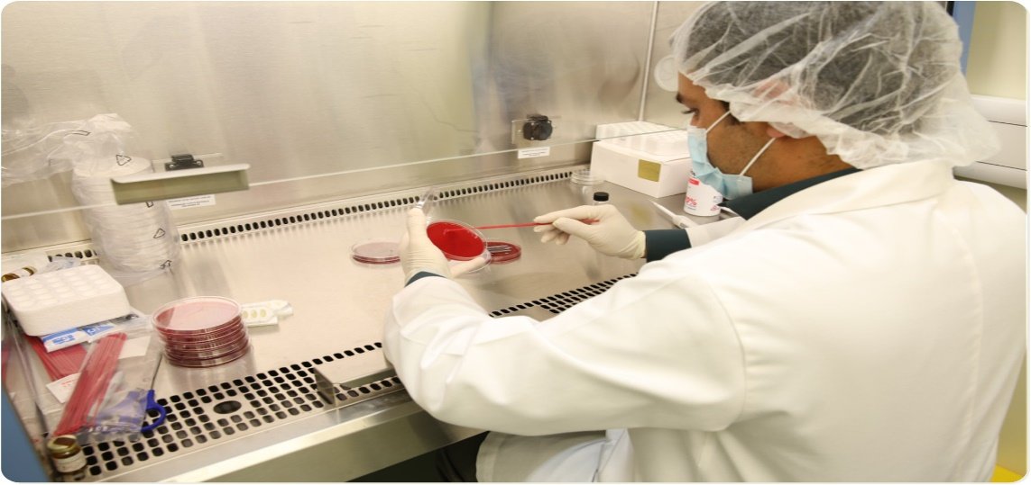
Online Course
Summer Internship
Microbiological monitoring system for SPF rodent facility
(7th June to 25th June 2020)
Session 1: LARC Laboratories Overview
Session 2: Good Lab Practice
Session3: Vivarium Environmental Monitoring
Session 1: Health Monitoring – Principle
Session 2: Health Monitoring - Methods
Session 3: Quality assurance – Diagnostic Labs
Session 1: Risk Management
Session 2: Waste Management
Final Presentation
Laboratory Animal research Centre
Research complex – H10 – Zone 8
Qatar University
WEEK 01 -
7th -11th June 2020
WEEK 02 -
14th -18th June 2020
WEEK 03 –
21st - 25th June 2020
Register now

